Slide 1
Aim High Preparing Yourself to Compete as an International Scholar

Slide 2
Agenda
Introductions
You, as an Author
You, as a Writer
You, as a Professional
Follow the links: https://blog.techlib.cz/index.php/zlin/

Slide 3
Introduce Yourself
Your name
Your research topic
Have you published in English?
Follow the links: https://blog.techlib.cz/index.php/zlin/

Slide 4
You, as an Author
ORCID
My ORCID: 0000-0001-6473-2954

Slide 5
You, as an Author
Online tools and profiles
LinkedIn, Google Scholar, ResearchGate
Example: Darrick Hamilton (Professor of Economics and Urban Policy at The New School, NYC, US)
LinkedIn
Google Scholar
ResearchGate

Slide 6
You, as an Author
Academic CV: Web / Full (Derrick Hamilton Example)

Slide 7
You, as an Author
Exercise:
With a partner, discuss your online presence
Tell the class about your partner’s online presence (or lack thereof)

Slide 8
You, an a Writer: Understanding the State-of-the-Art
Getting Ready:
Google Scholar Settings & Kopernio
Understanding WOS v. SCOPUS v. Scholar
Follow citations
Find journal rankings
Key resources in Business & Economics

Slide 9
The Problem: No One-Stop Shopping
Houle, L. (2017). Google Scholar, Sci-Hub and LibGen: Could they be our New Partners?. Proceedings of the IATUL Conferences. Paper 3, 9. http://docs.lib.purdue.edu/iatul/2017/partnership/
McKenzie, L. (2017). Sci-Hub’s cache of pirated papers is so big, subscription journals are doomed, data analyst suggests. Science News. doi:10.1126/science.aan7164

Slide 10
You, as a Writer (=a READER)
Kopernio plug-in
Google Scholar Settings
Library links
Citation settings
tax reform czech republic (since 2014)

Slide 11
You, as a Writer (=a READER)
WOS v. SCOPUS v. Scholar (+ SJR, PlumX)
publons (peer review + journal white list)
Definition: h-index
h=largest integer for which the following is true:
At least h papers of the given researcher have been cited at least h time (each)

Slide 12
You, as a Writer (=a READER)
Source: Jirásek, M. & Zeman, J. (2018). Evaluation of Journals, Researchers and Institutions. Scientific Writing in English, Czech Technical University and NTK. 10.4.2018

Slide 13
Library Resources
Library discovery tool: http://portal.k.utb.cz/?lang=cze
Specialized resources: http://portal.k.utb.cz/databases/alphabetical/?lang=cze
Help if you can’t find a copy: http://www.utb.cz/knihovna/sluzby/meziknihovni-vypujcni-sluzba
Citation management: http://www.utb.cz/knihovna/sluzby/citace
Notes:
Live demo

Slide 14
Other Organization Tools
Mendeley
zotero

Slide 15
Not Easy: Publishing Decisionmaking
“My take on this is that more and more it is the quality of the individual article that matters, not necessarily the quality of the journal. Good papers get published in predatory journals and poor quality papers get published in reputable, high-impact journals due to the well-known issues that can occur with peer review. Journal quality and reputation was very important in the days of purely paper journals when it was a guiding factor in deciding what to include in a library’s collection. But the lines are very much blurred now that articles are available online open-access.
Critical appraisal skills, to assess the quality of individual articles, are more and more essential.”
Dr Douglas Grindlay Information Specialist Centre of Evidence Based Dermatology University of Nottingham King’s Meadow Campus
[EXPERTSEARCHING-L]

Slide 16
Key Questions Review
What key steps can save me time when I perform academic literature searches?
What if my favorite P2P server goes down?
Where do I go if there’s something I can’t find or to get assistance?

Slide 17
You, As A Writer (=a READER)
Exercise:
Freewriting (10 minutes):
Have you identified at least 50 articles on your dissertation topic? Why or why not? What difficulties have you had?
OR:
Can you describe your primary research question in a way that an undergraduate would understand?
Be prepared to discuss

Slide 18
You, as a Professional
Your plan for the next year (handout, Don Davis, Columbia University)
Research
Publishing
Conferences
3-5 year goal planning
Academia or corporate?
CZ or abroad?
Postdoc or…?
AEA: The Economics Profession
EURAXESS
Angus Deaton, Nobel Prize in Economic Sciences, 2015 (GS h-index 105)

Slide 19
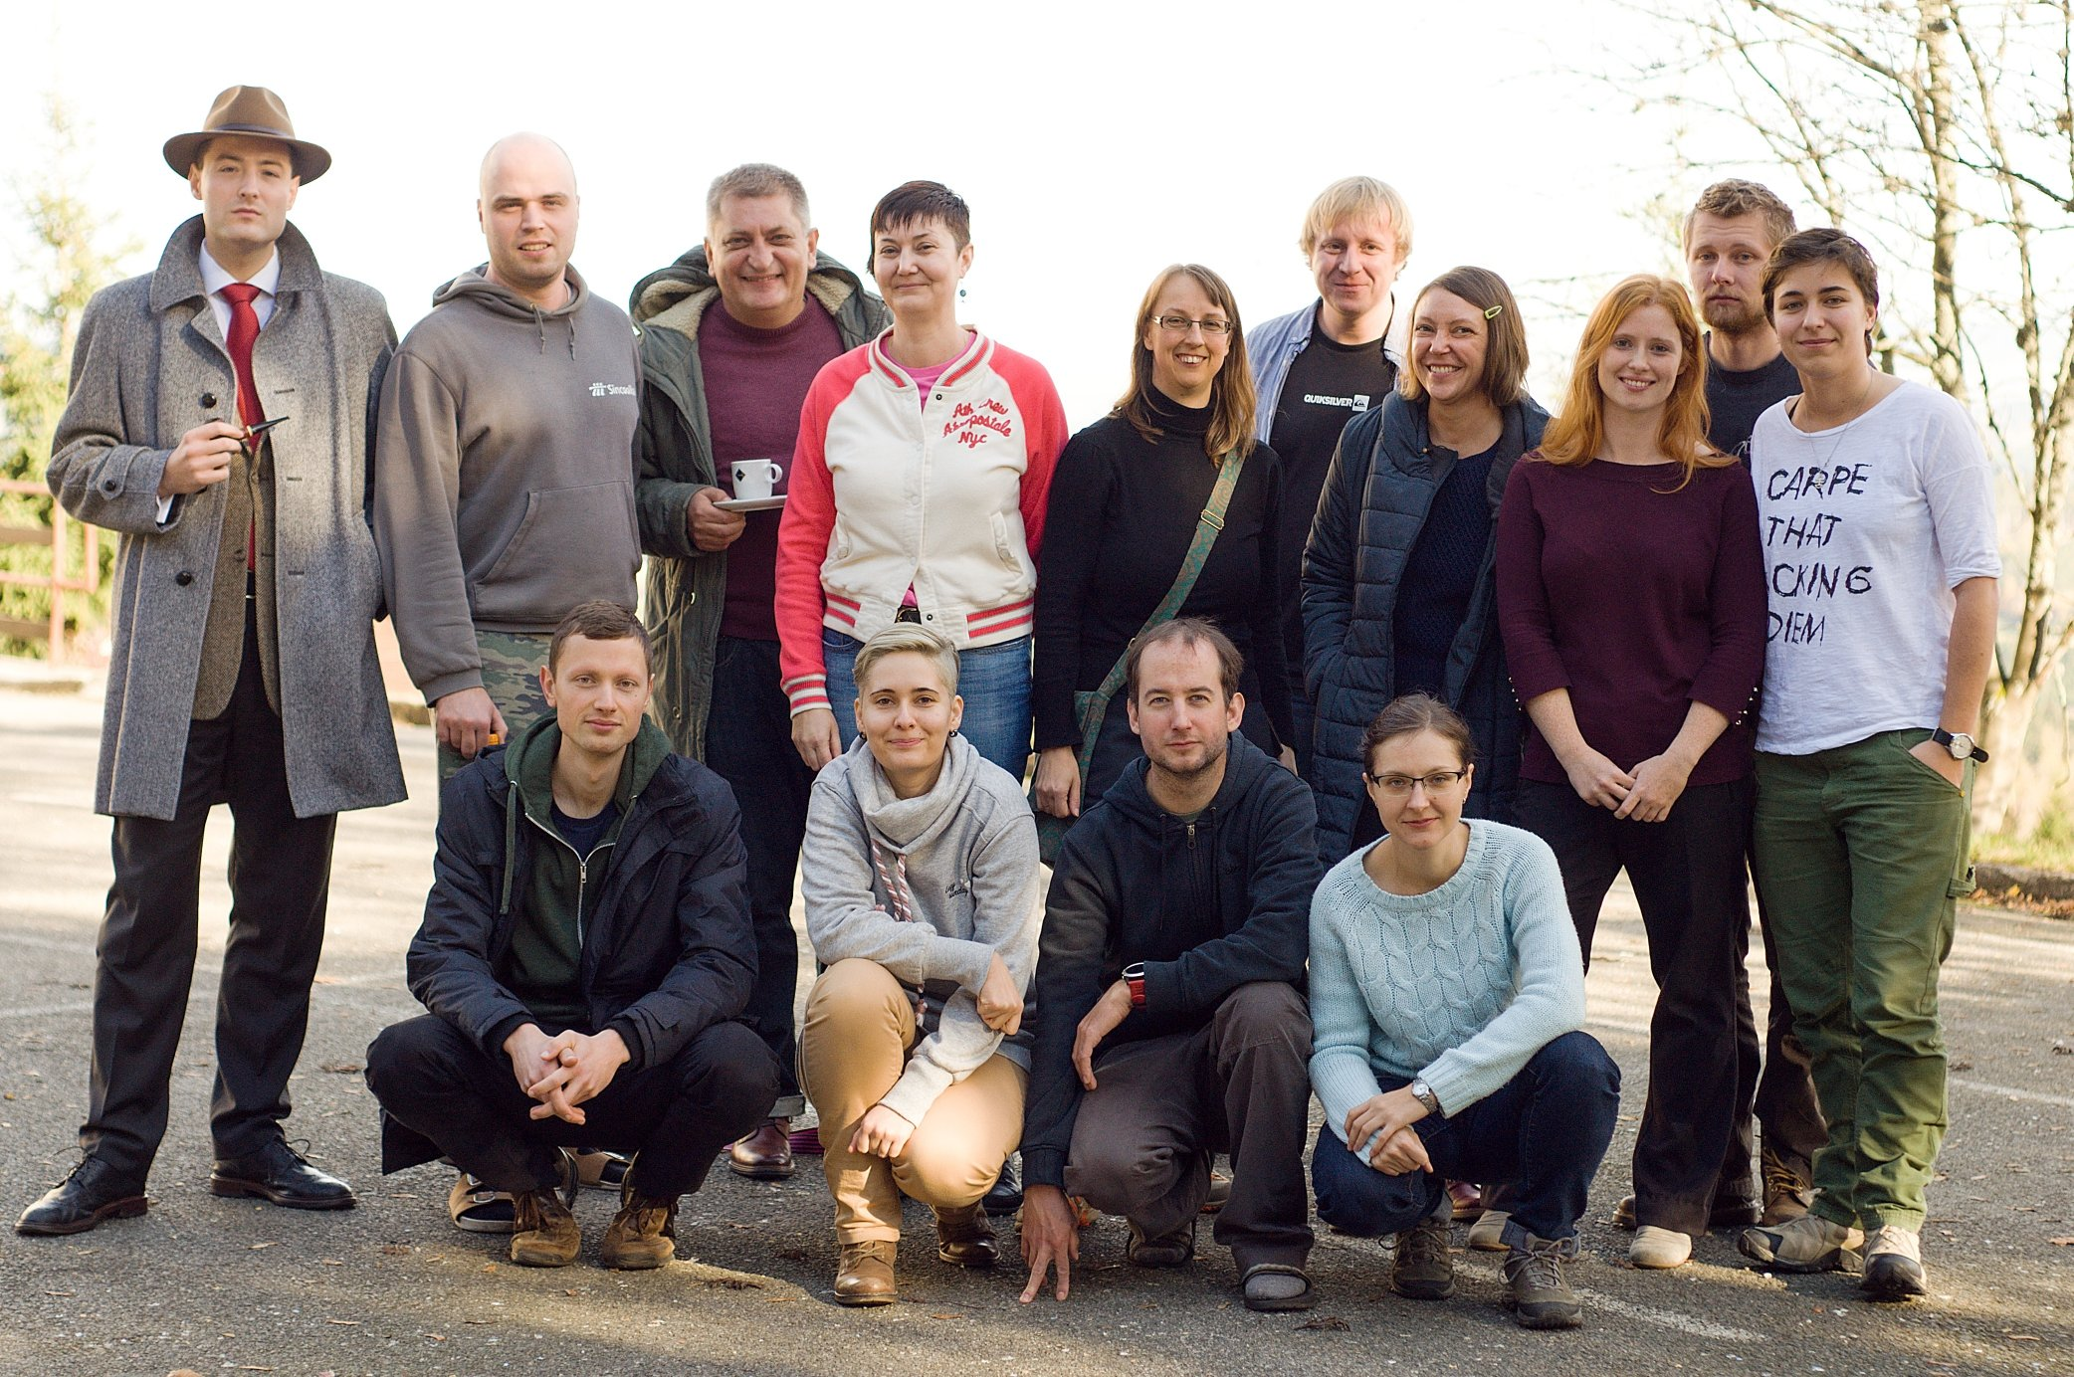
Contact:
Dr. Stephanie Krueger
Head, Specialized Academic Services
stephanie.krueger@techlib.cz
Your plan for the next year
3-5 year goal planning

