Slide 1
Jan Červenka

Slide 2
SAGE Publications Ltd
Founded in 1965 by Sara Miller McCune.
SAGE is a leading independent, academic and professional publisher of innovative, high-quality content.
With over 1,500 employees globally from principal offices in Los Angeles, London, New Delhi, Singapore, and Washington, D.C.
SAGE now publishes more than 900 journals and over 800 books a year, in business, humanities, social sciences, science, technology and medicine.

Slide 3
A little history of SAGE
1965 SAGE granted its corporate charter in New York City.
1966 Sara Miller moves to California, marries George McCune, forming the union that inspired the company’s name - SAra and GEorge (SAGE).
1971 SAGE Publications, Ltd. established in London.
1981 SAGE Publications India Pvt. Ltd. established in New Delhi.

Slide 4
SAGE STM Package
The SAGE Science, Technology, and Medicine (STM) Packages include:
Access up to 368 SAGE journals, including leading international peer-reviewed titles. NTK now subscribes to 332 out of 368 SAGE journals.
Over 60% of the package content is ranked in the Thomson Scientific Journal Citation Reports® (Thomson Reuters).
Complimentary access back to 1999, where available, while a current subscription is maintained.
https://uk.sagepub.com/sites/default/files/copy_of_stm-2017-title-list-1.xlsx

Slide 5
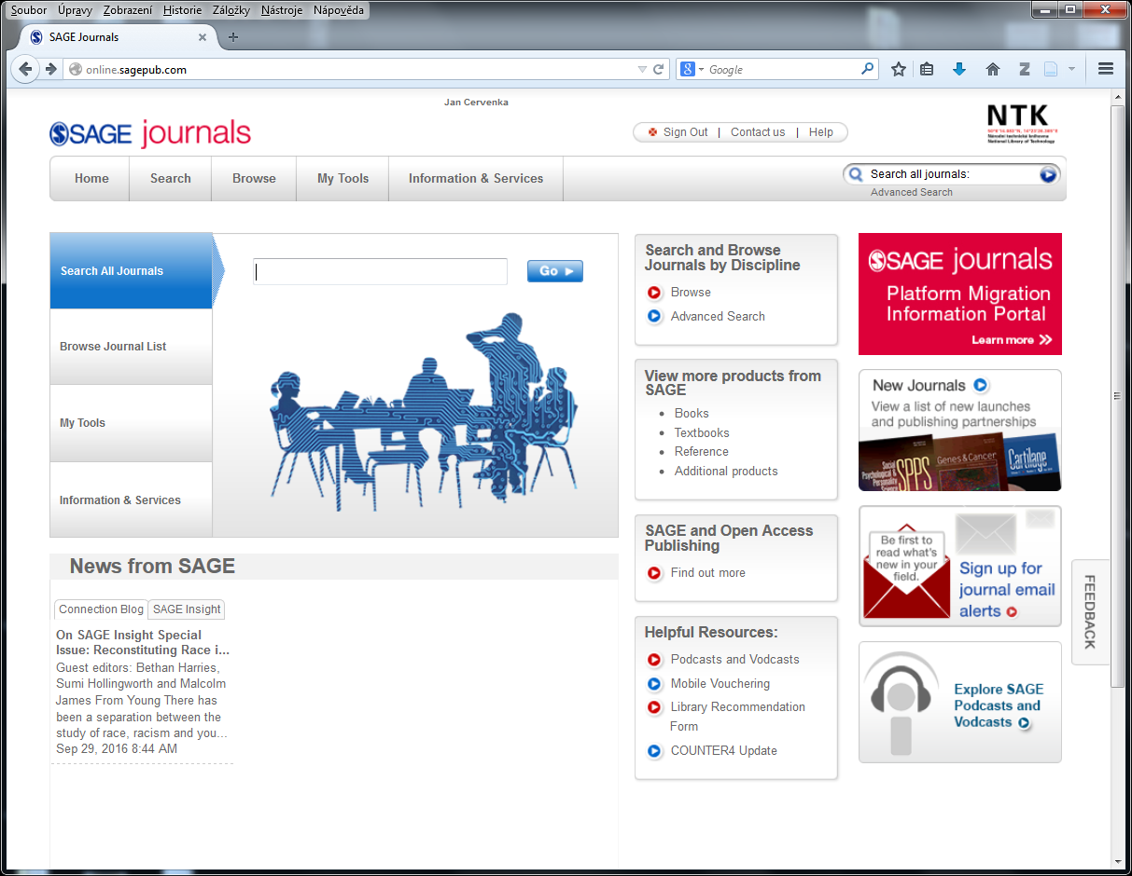

Slide 6
Searching Example #1
YU, Chih-Han and Radhika NAGPAL. A Self-adaptive Framework for Modular Robots in a Dynamic Environment: Theory and Applications. The International Journal of Robotics Research [online]. 2011, vol. 30, no. 8, pp. 1015-1036. ISSN 0278-3649.

Slide 7
Searching Example #2
HAUGHTON, D. M. Exact Solutions for Elastic Membrane Disks. Mathematics and Mechanics of Solids [online]. 1998, vol. 3, no. 4, pp. 393-410. ISSN 1081-2865.
(Dec 1998 issue no. 4)

Slide 8
Searching Example #3
HILL, James M. and Daniel J. ARRIGO. Transformations and Equation Reductions in Finite Elasticity III: A General Integral for Plane Strain Deformations. Mathematics and Mechanics of Solids [online]. 1999, vol. 4, no. 1, pp. 3-15. ISSN 1081-2865.
(Mar 1999 issue no. 1)

Slide 9
Searching Example #4
SZULADZIŃSKI, Gregory, Anthony SZAMBOTI and Richard JOHNS. Some Misunderstandings Related to WTC Collapse Analysis. International Journal of Protective Structures [online]. 2013, vol. 4, no. 2, pp. 117-126. ISSN 2041-4196.
(Intl. Journal of Protective Structures is within the STM Package)

Slide 10
Searching Example #5
LE, Jia-Liang and Zdeněk P. BAŽANT. Why the Observed Motion History of World Trade Center Towers Is Smooth. Journal of Engineering Mechanics [online]. 2011, vol. 137, no. 1, pp. 82-84. ISSN 0733-9399.

Slide 11
Searching Example #6
NELLIS, Jason C., Ralph P. TUFANO and Christine G. GOURIN. Association between Magnesium Disorders and Hypocalcemia following Thyroidectomy. Otolaryngology--Head and Neck Surgery : Official Journal of American Academy of Otolaryngology-Head and Neck Surgery [online]. 2016, vol. 155, no. 3, pp. 402-410. ISSN 0194-5998.
(Sep 2016 which is the last but one issue)

Slide 12
Searching Example #7
QIN, Li, Fang WU, Heming LU, Bo WEI, Guisheng LI and Rensheng WANG. Tumor Volume Predicts Survival Rate of Advanced Nasopharyngeal Carcinoma Treated with Concurrent Chemoradiotherapy. Otolaryngology -- Head and Neck Surgery: Official Journal of American Academy of Otolaryngology-Head and Neck Surgery [online]. 2016, vol. 155, no. 4, pp. 598-605. ISSN 0194-5998.
(Oct 2016 which is the current issue)

