Slide 1
Introduction to Research Data Management … and how not to get overwhelmed by data
Workshop lecturer: Jan Vališ
Authors of the presentation: Adéla Jílková, Martin Schätz, Jan Vališ
April 2, 2025
Content of this presentation is licensed via CC BY 4.0,
except where otherwise noted for content created
by third-parties.

Slide 2
What is research data
and
why manage it?

Slide 3
Research data
Any information collected, observed, generated, or created during the research process to produce and support research findings
Primary data
Directly from a given research
Quantitative (volume) vs. Qualitative (interview)
Experimental (pH) vs. Observational (bird migration)
Secondary data
From other research used for different reason

Slide 4
Research data management
A set of practices, strategies, and activities, including data:
organization,
documentation,
storage, and
sharing
Covers all stages of the research process
Ensures the effectiveness, reproducibility, and reuse of research data

Slide 5
Question #3: What is your main motivation to attend?
Necessary evil – somebody wants me to do a DMP
Setting up effective practices to take care of my data
I want to proudly share my data and not be ashamed of its state
I want others to be able to take advantage of my data
If other, please, let us know in the chat

Slide 6
Why manage research data?
It can help:
Keep the research process organized, secure, and smooth
Increase efficiency, save time and resources
Share data with colleagues
Reduce risk of data loss and improve data security
Enhance global data sharing (Open Science and FAIR principles)
Enable data reuse and enhance collaboration
Increase the visibility and impact of research
Increase transparency and improve trust in research findings
Support research integrity and validation of research results
It may be mandatory (institutional, publisher, or research funder requirements)

Slide 7
Research data
Different fields and disciplines
Natural and life sciences
Medical and health sciences
Engineering and technology
Social sciences
Arts and humanities

Slide 8
Research data
Different fields and disciplines
Natural and life sciences
Medical and health sciences
Engineering and technology
Social sciences
Arts and humanities
Different stages of research data lifecycle
Data
Reusing
Data
Collection
Data
Lifecycle
Data
Archiving
Data Processing
Data
Publishing
Data
Analysis
Adapted from “Research Data Lifecycle“ by UK Data Service,
used under Creative Commons Attribution license (CC BY)

Slide 9
Research data lifecycle
Data
Reusing
Data
Collection
Data
Lifecycle
Data
Archiving
Data Processing
Data
Publishing
Data
Analysis
Adapted from “Research Data Lifecycle“ by UK Data Service,
used under Creative Commons Attribution license (CC BY)

Slide 10
Research data lifecycle
Source Data
Collected/produced “raw data“
Reused data from a database/repository
Data
Reusing
Data
Collection
Data
Lifecycle
Data
Archiving
Data Processing
Data
Publishing
Data
Analysis
Adapted from “Research Data Lifecycle“ by UK Data Service,
used under Creative Commons Attribution license (CC BY)

Slide 11
Research data lifecycle
Source Data
Collected/produced “raw data“
Reused data from a database/repository
Data Processing
Transformation of raw data
Data
Reusing
Data
Collection
Data
Lifecycle
Data
Archiving
Data Processing
Data
Publishing
Data
Analysis
Adapted from “Research Data Lifecycle“ by UK Data Service,
used under Creative Commons Attribution license (CC BY)

Slide 12
Research data lifecycle
Source Data
Collected/produced “raw data“
Reused data from a database/repository
Data Processing
Transformation of raw data
Data
Reusing
Data
Collection
Data Analysis
Data interpretation
Generation of results and outputs
Data
Lifecycle
Data
Archiving
Data Processing
Data
Publishing
Data
Analysis
Adapted from “Research Data Lifecycle“ by UK Data Service,
used under Creative Commons Attribution license (CC BY)

Slide 13
Research data lifecycle
Source Data
Collected/produced “raw data“
Reused data from a database/repository
Data Processing
Transformation of raw data
Data
Reusing
Data
Collection
Data Analysis
Data interpretation
Generation of results and outputs
Data
Lifecycle
Data Publishing
Journal article
Manuscript + supplementary information
Databases/repositories
Data underlying publication
Separate datasets
Data
Archiving
Data Processing
Data
Publishing
Data
Analysis
Adapted from “Research Data Lifecycle“ by UK Data Service,
used under Creative Commons Attribution license (CC BY)

Slide 14
Research data lifecycle
Source Data
Collected/produced “raw data“
Reused data from a database/repository
Data Processing
Transformation of raw data
Data
Reusing
Data
Collection
Data Analysis
Data interpretation
Generation of results and outputs
Data
Lifecycle
Data Publishing
Journal article
Manuscript + supplementary information
Databases/repositories
Data underlying publication
Separate datasets
Data
Archiving
Data Processing
Data
Publishing
Data
Analysis
Data Archiving
Adapted from “Research Data Lifecycle“ by UK Data Service,
used under Creative Commons Attribution license (CC BY)

Slide 15
Research data lifecycle
Source Data
Collected/produced “raw data“
Reused data from a database/repository
Data Processing
Transformation of raw data
Data
Reusing
Data
Collection
Data Analysis
Data interpretation
Generation of results and outputs
Data
Lifecycle
Data Publishing
Journal article
Manuscript + supplementary information
Databases/repositories
Data underlying publication
Separate datasets
Data
Archiving
Data Processing
Data
Publishing
Data
Analysis
Data Archiving
Data Reusing (registries, repositories)
Adapted from “Research Data Lifecycle“ by UK Data Service,
used under Creative Commons Attribution license (CC BY)

Slide 16
RDM strategies
Organizing
Directory structure
Formats, names, versions
Data
Reusing
Data
Collection
Documentation
Data description
Experimental details
Decisions made
Metadata
Data
Lifecycle
Data
Archiving
Data Processing
Storage
Backup
Long-term preservation
Data
Publishing
Data
Analysis
Data access
Access rights (open, restricted)
Licenses
Adapted from “Research Data Lifecycle“ by UK Data Service,
used under Creative Commons Attribution license (CC BY)

Slide 17
RDM strategies
Generate ideas
Design research
Funding proposal
Plan
Organizing
Directory structure
Formats, names, versions
Data
Reusing
Data
Collection
Documentation
Data description
Experimental details
Decisions made
Metadata
Data
Lifecycle
Data
Archiving
Data Processing
Storage
Backup
Long-term preservation
Data
Publishing
Data
Analysis
Data access
Access rights (open, restricted)
Licenses
Adapted from “Research Data Lifecycle“ by UK Data Service,
used under Creative Commons Attribution license (CC BY)

Slide 18
Examples of research data requirements and policies
Generate ideas
Design research
Funding proposal
Funding agency policies
Open Access policy
Data management plan
Plan
Legal and ethical requirements
National and European legislation
Ethical framework for researchers
Personal data protection
Intellectual property rights
Commercial use of data
Data
Reusing
Data
Collection
Data
Lifecycle
Data
Archiving
Data Processing
Institutional policies
RDM policy
Codes of conduct and ethics
Data protection
Partnership agreement (for collaboration)
Data
Publishing
Data
Analysis
Journal & Publisher policies
Data sharing policy
Adapted from “Research Data Lifecycle“ by UK Data Service,
used under Creative Commons Attribution license (CC BY)

Slide 19
How to approach
Research Data Management

Slide 20
What (not) to publish?
Personal data
Sensitive data
Data protected by legitimate interest:
Intellectual Property
Commercial interests

Slide 21
What to do with these data?
Can the data be
anonymized?
shared with informed consent?
shared later (embargo)?
shared only with selected researchers (controlled access)?
If not, we can still usually share at least metadata

Slide 22
So … what are metadata?
Metadata = documentation describing data = “data about data”
Properly describing and documenting data allows others to understand and track important details of the work
Machine readability → search & retrieval of data from repository.
Metadata: who, what, when, where, why, how

Slide 23
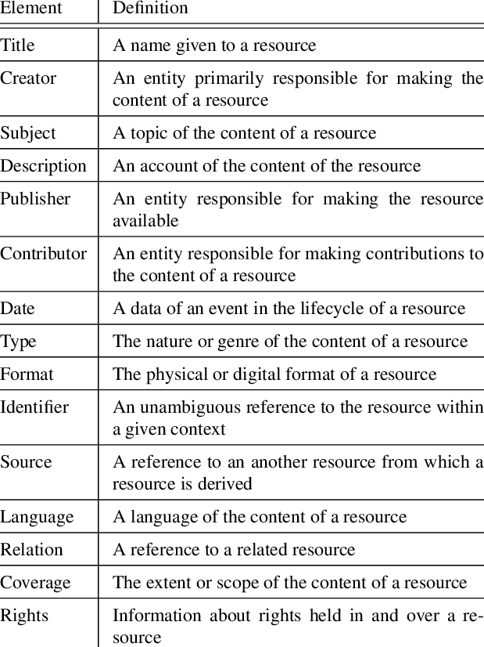
Dublin Core (1999, Dublin, Ohio)
A set of 15 metadata tags:
Creator Contributor
Publisher Title
Date Language
Format Subject
Description Identifier
Relation Source
Type Coverage
Rights

Slide 24
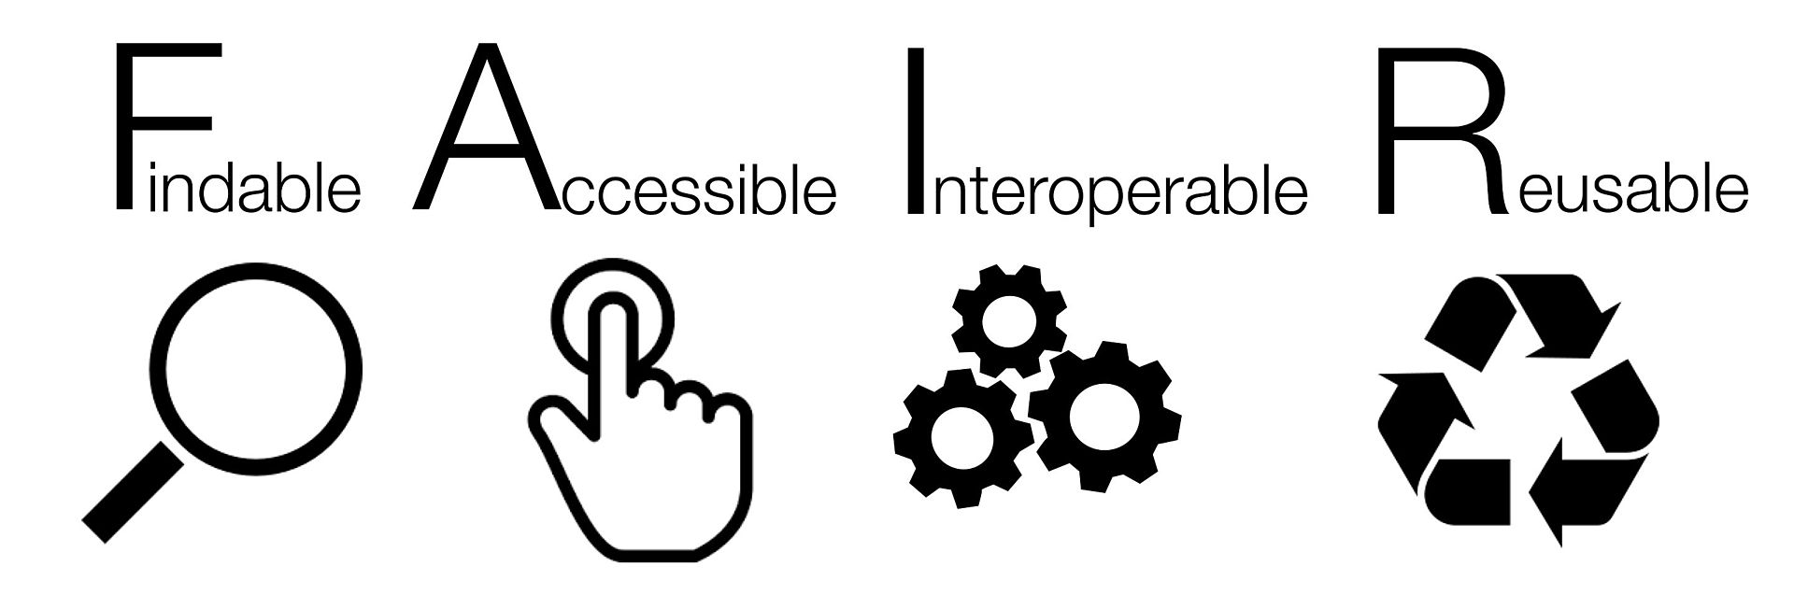
FAIR principles
zdroj: SangyaPundir, FAIR data principles, CC BY-SA 4.0
Findable
Metadata
Persistent Identifiers (DOI, ORCiD ID)
Registration and indexing in searchable repository
Accessible
Free and open metadata
Availability of metadate even when proper data are not available
Interoperable
Widely used language
Preferred formats
Vocabularies and ontologies
Reusable
Rich description (Read Me File)
Licence
Field/Community standards

Slide 25
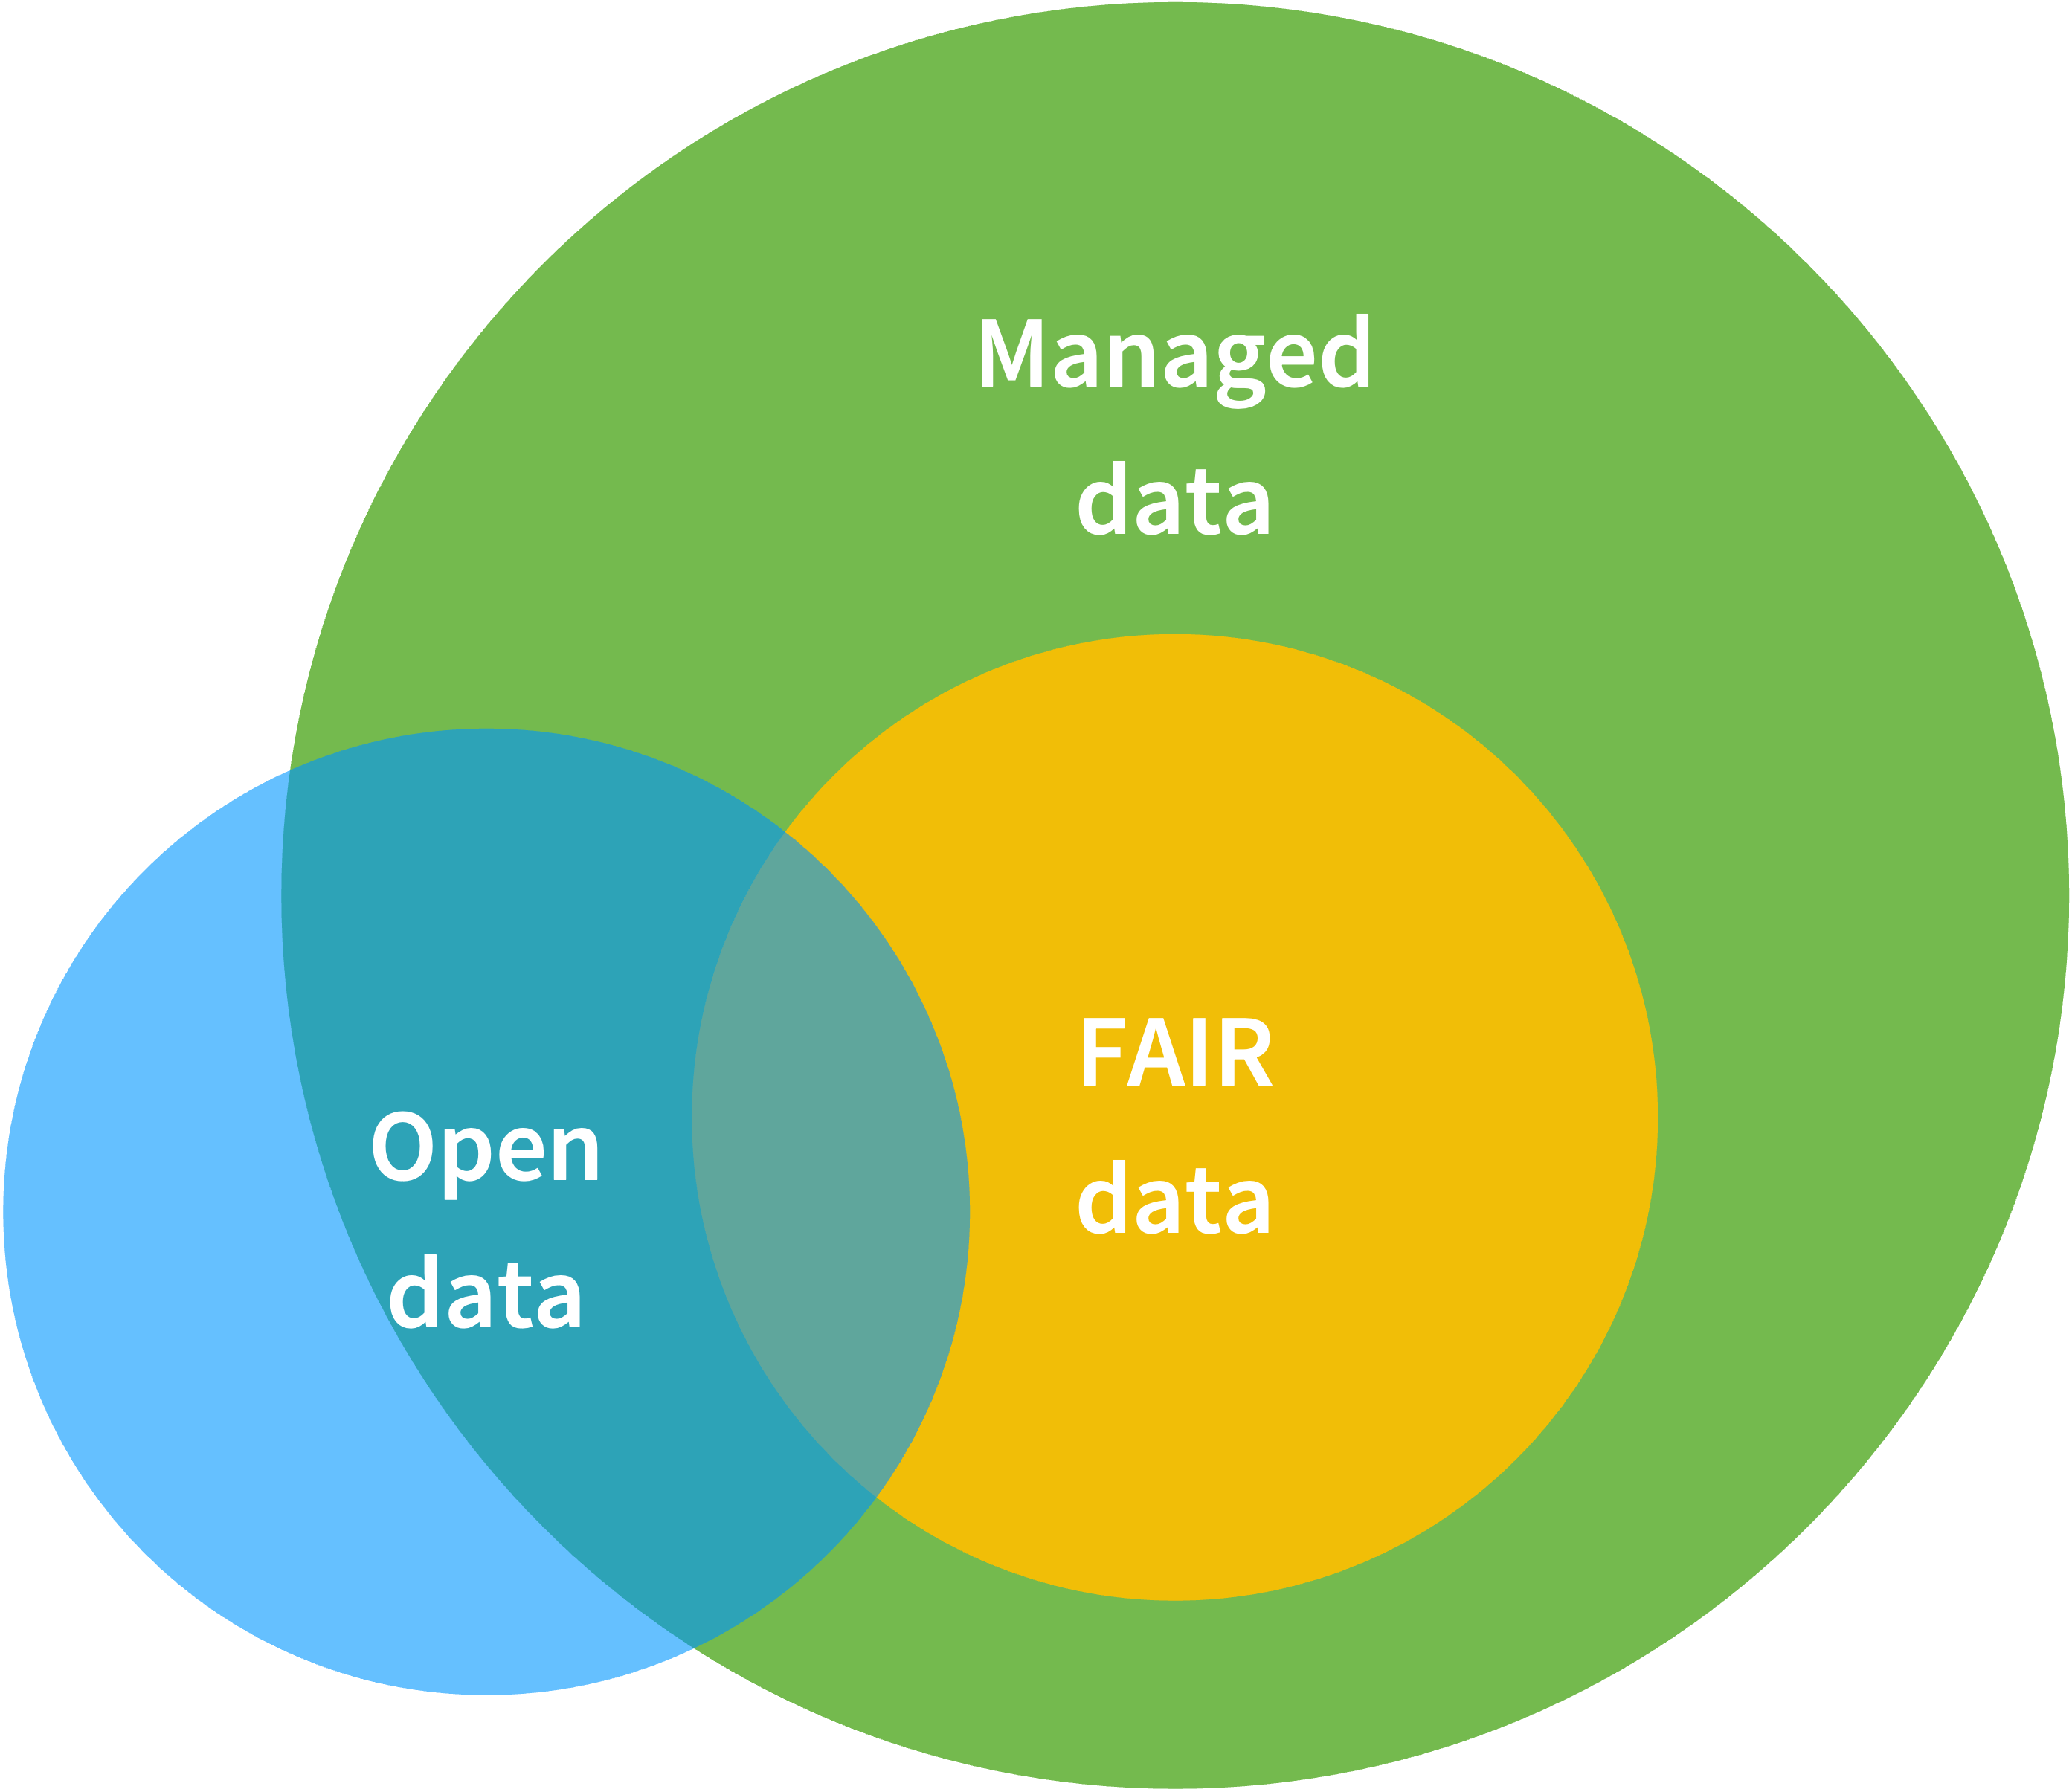
Open vs FAIR Data
Source: Valis, Jan (2024). FAIR vs. Open Data (Venn diagram). doi.org/10.6084/m9.figshare.25648548.v1; Available via license: CC BY

Slide 26
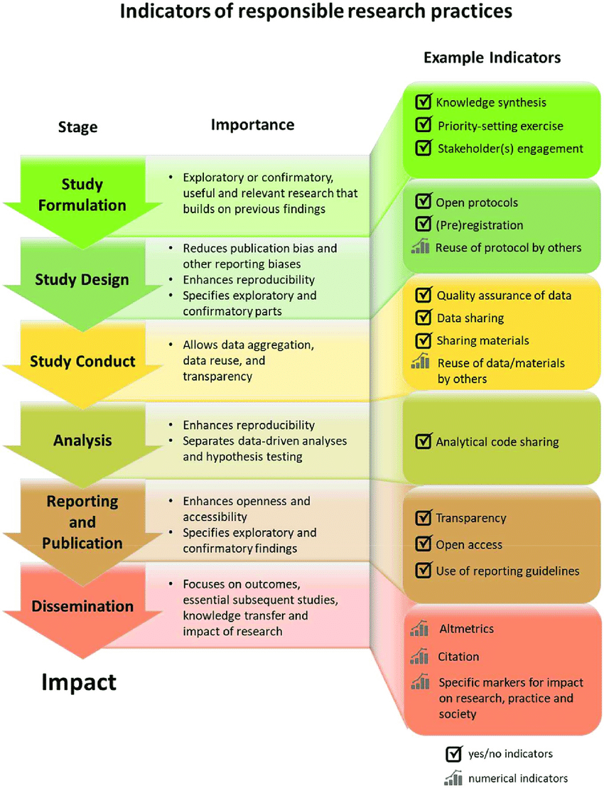
Responsible Research Practice
For knowledge to benefit research and society, it must be trustworthy.
Trustworthy research is robust, rigorous, and transparent at all stages of design, execution, and reporting.
Assessment of researchers still rarely includes considerations related to trustworthiness, rigor, and transparency.
DOI: 10.1371/journal.pbio.3000737.g001; Available via license: CC BY

Slide 27
We need to plan in advance – DMP
Instruments
Can we properly document what we are doing, and how?
Size
Do we have enough storage for the captured data?
Software
Do we have workflow for processing of data?
Do we have access to proper software?
Can we use open file formats?
Ethics
Are there any set procedures for data processing?
Collaboration and services
Personal/sensitive data
Ethical comitte consent?

Slide 28
We need to plan in advance – DMP
Backup
How and where?
Do we need encryption and access control?
Copyright License
How are we legally bound?
How do we want to license our results?
Publishing
Can we publish data?
Is there any domain-specific repository?
Archiving
What data to archive?
How long?

Slide 29
Question #4: How much would cost you to archive 100 TB of your research data for 10 years?
10 000 CZK
100 000 CZK
1 000 000 CZK
10 000 000 CZK

Slide 30
Price of storage (AWS)
Standard First 50 TB/Month $0.023 per GB → 13 517$ per year Next 450 TB/Month $0.022 per GB → 121 651$ per year Over 500 TB/Month $0.021 per GB → 129 024$ per year
Archive Archive Access Tier All Storage/Month $0.0036 per GB 100TB → 4 424$ per year
Deep Archive Access Tier All Storage/Month $0.00099 per GB 100TB → 1 217$ per year

Slide 31
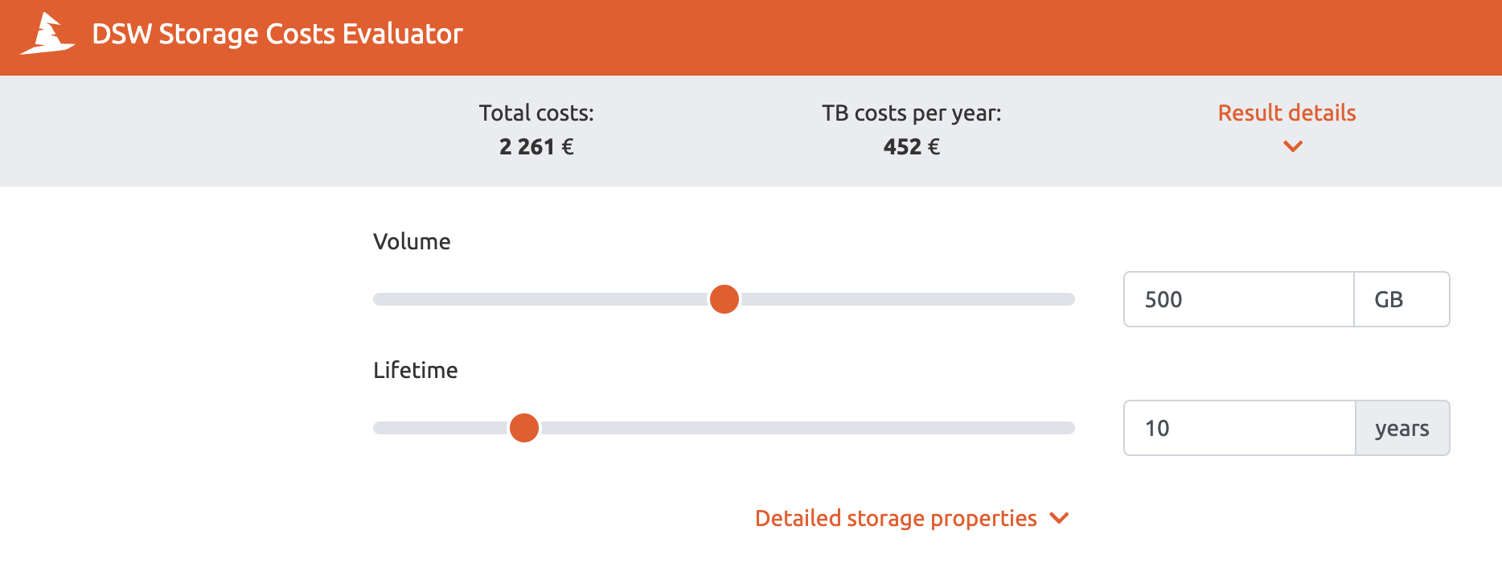
Pricing estimation
Source: https://storage-costs-evaluator.ds-wizard.org/

Slide 32
Tools to help you with DMP
Data Stewardship Wizard
DMP Online
Argos

Slide 33
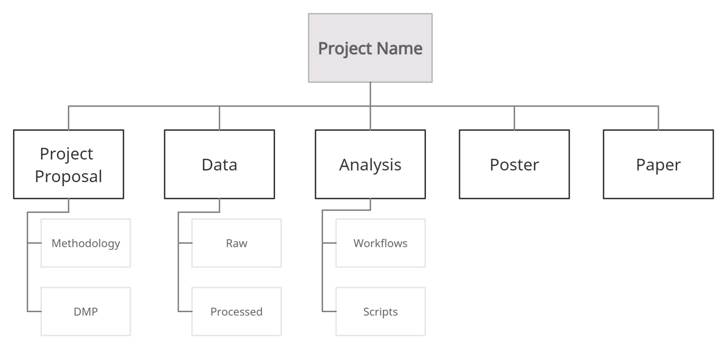
Organizing your data
Source: https://biblio.uottawa.ca/en/services/faculty/research-data-management/file-naming-and-organization-data

Slide 34
Organizing your data
Restrict level of folders to three or four deep
Consider limiting the number of folders within each folder, to ten
Include a folder within the folder structure for “documentation”. This might include:
Project proposals/protocols
Consent and approval forms
Methodology documents
Data management plan
Code used for recodes, analysis, and outputs
Readme files with transformation information
Readme files with the full names or titles for any abbreviations used in file names
Codebooks or guides

Slide 35
Setup naming convention
Edited from: https://biblio.uottawa.ca/en/services/faculty/research-data-management/file-naming-and-organization-data

Slide 36
Setup naming convention
Avoid using spaces, dots and special characters (& or ? or !)
Use hyphens (-), underscores (_), or capitalization to separate elements in a file name
Include an abbreviation in the file name to identify
The instrument used
The phase (if research has multiple phases)
The transformation phase (i.e., original, raw, compressed, digitized, recoded, restructured, cleaned)
The source of third-party data (data provider or principal investigator)
The team (if working with multiple teams)
The language (if working with multiple languages)
Include versioning within file names as appropriate

Slide 37
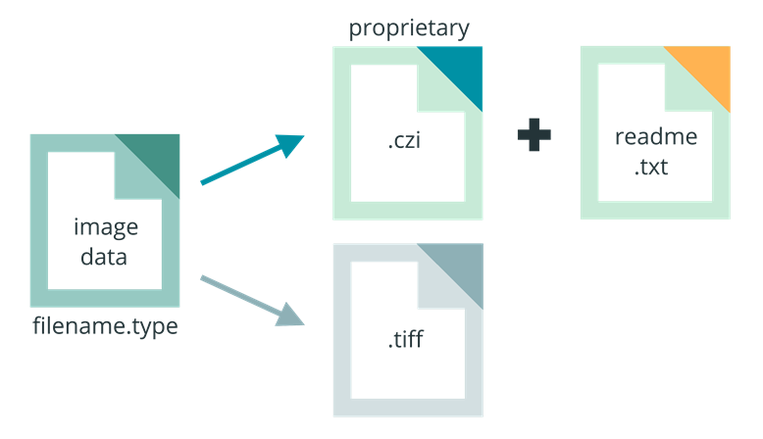
File formats
Preferred vs. popular
Open vs. proprietary
When necessary to use a proprietary format, consider including a readme.txt file in your directory that documents the name and version of the software used to generate the file, as well as the company that made the software. This could help you down the road, if you need to figure out how to open these files again.
source: https://www.howtofair.dk/how-to-fair/file-formats/

Slide 38
Specific file types
Here are some examples of preferred FAIR file formats for preservation:
Images: TIFF, JPEG 2000, PDF, PNG, GIF, BMP, SVG
Tabular data: CSV, TXT
Text: XML, PDF/A, HTML, JSON, TXT, RTF
Containers: TAR, GZIP, ZIP
Databases: XML, CSV, JSON
Geospatial: SHP, DBF, GeoTIFF, NetCDF
Video: MPEG, AVI, MXF, MKV
Sounds: WAVE, AIFF, MP3, MXF, FLAC
Statistics: DTA, POR, SAS, SAV

Slide 39
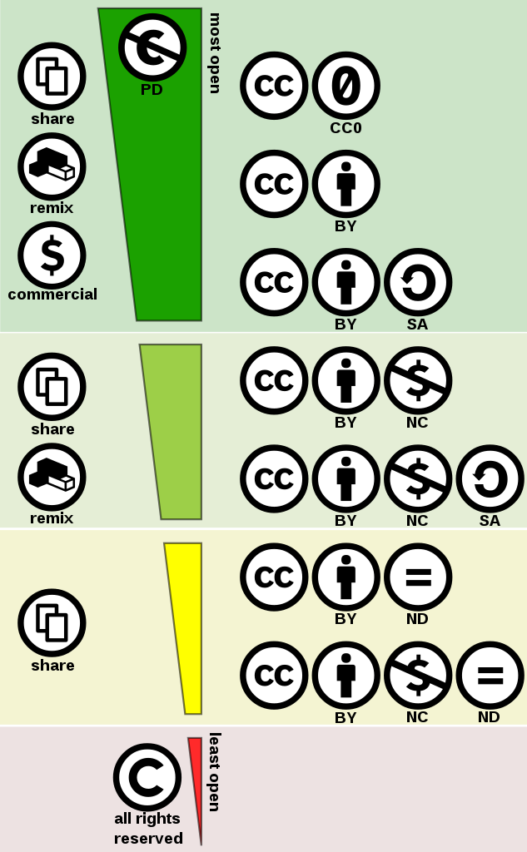
Creative Commons license
Easy to understand/use
Meaning of CC suffix:
0 - Public domain BY - By Attribution ND - No Derivatives NC - Non-Commercial SA - Share Alike
Source: https://creativecommons.org/

Slide 40
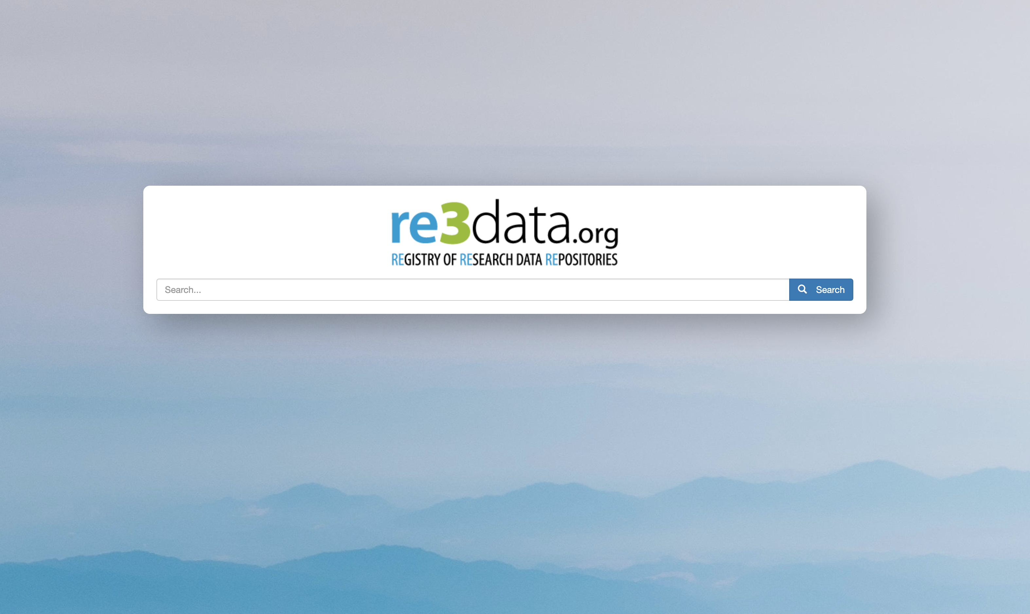
Source: https://www.re3data.org

Slide 41
Source: https://www.re3data.org

Slide 42
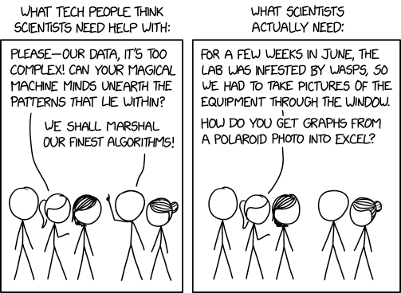
Electronic laboratory notebook
The missing infrastructure for data recording, retrieval, and integrity.
There are many options, from utilizing Google Colaboratory up to all-in-one solutions:
https://www.labfolder.com/electronic-lab-notebook-eln-research-guide/
Source: https://xkcd.com/2341/; Available via license: CC BY NC 2.5

Slide 43
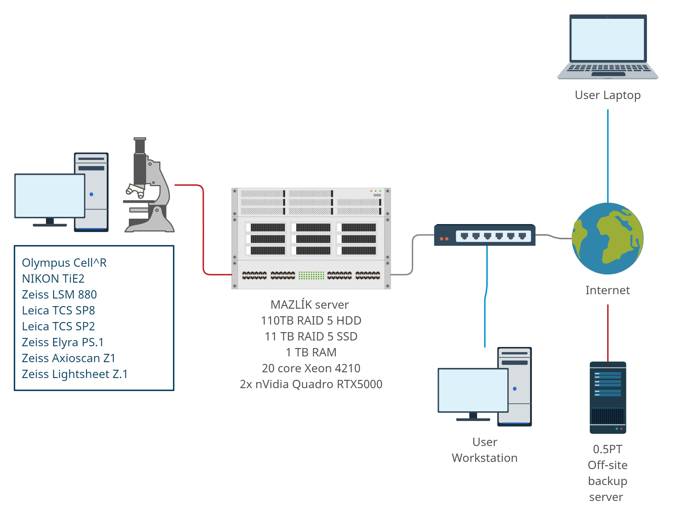
How it looks in practice: VMCF
Many limitations:
RDM
Length of experiments
Data ownership
Documenting
Ethics
Access planning
Cost management

Slide 44
Research data management resources
Course: Data Stewardship: module 1, DocEnhance (2021)
https://moodle.techlib.cz/course/view.php?id=179
Developed as part of the DocEnhance project
The Data Stewardship course was piloted in Norway and Czech republic
Course was developed for early-career researchers
Entry level self-guided open course to data stewardship
11 modules on various aspects of data management
Ended by self examination with certificate

Slide 45
What to take home?
Research data management:
is a helpful tool, not just an administrative task
is a good scientific practice
can save time and money
≠ Open Science, but sharing can createe impact
Communities define standards and they are usually open to others joining their efforts. The same is happening at the national level.
There are already many on-line resources to learn from.
Funding providers are already demanding Data Management Plans and often support RDM tasks financially.

Slide 46
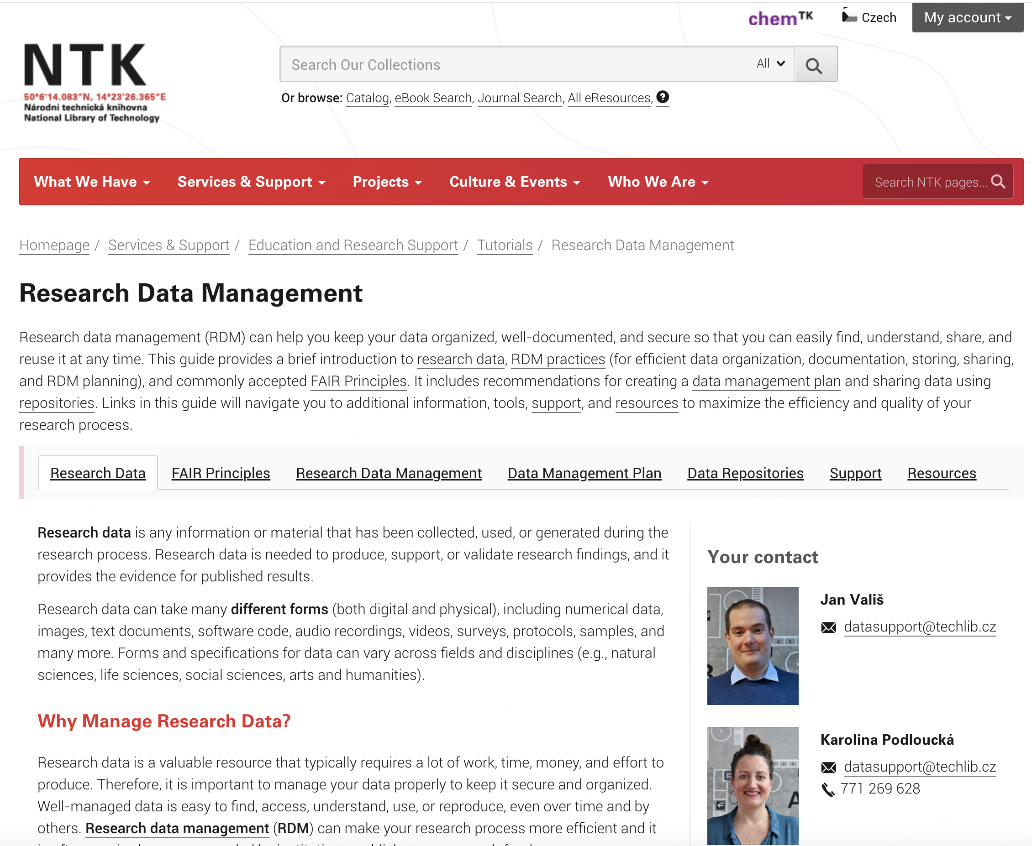
Research data management guide
https://www.techlib.cz/en/84974

Slide 47
Research data management resources
Data Stewardship Course: module 1 https://moodle.techlib.cz/course/view.php?id=179
Developed as part of the DocEnhance project, Piloted in Norway and Czechia
Course was developed for early-career researchers
Entry level self-guided open course to data stewardship
11 modules on various aspects of data management
Finished by self examination with certificate
EOSC CZ – webinars (all fields)
RDMkit (life-sciences)
OpenAIRE (all fields)
Your institutional Data Stewards or librarians
Community

Slide 48
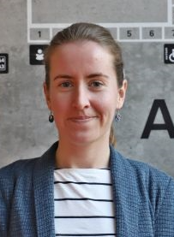
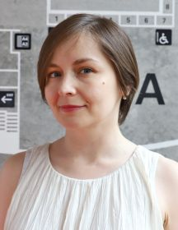
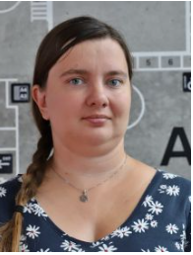
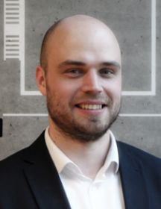
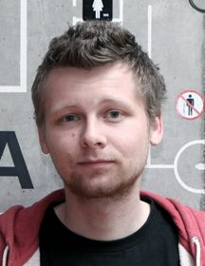
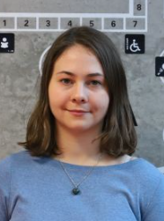
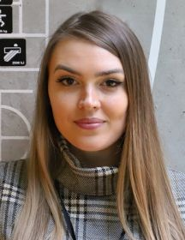
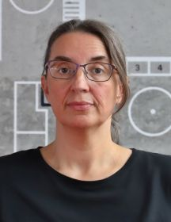
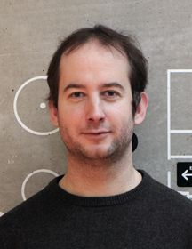
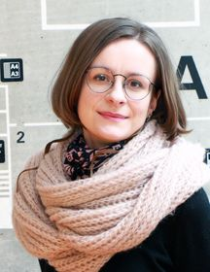
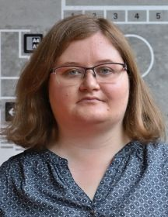
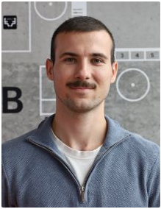
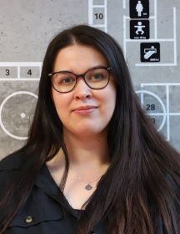
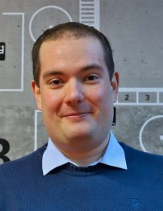
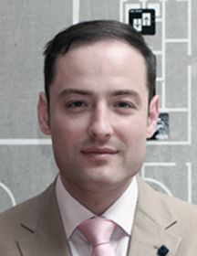
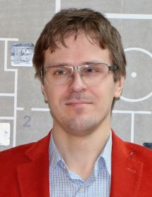
Get Assistance
1) Schedule a consultation with us
Don’t be shy; our team includes doctoral candidates who understand the issues you face
2) Attend another webinar
3) Explore on your own
AI tools for research: roadmap of AI tools for academic purposes
STEMskiller: comprehensive skills set map for early career researchers
Tutorials: NTK instructional materials and recordings, further resources
4) Stay ahead in your research journey!
Subscribe to our newsletter for updates on academic resources, writing support, publishing, research evaluation, and training opportunities.

Slide 49
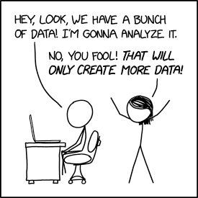
Contact
Jan Vališ
jan.valis@techlib.cz
Thank you
Source: https://xkcd.com/2582/; Available via license: CC BY NC 2.5
Questions?

