Slide 1
From mathematical logic to library and information science
Dr. Göran Hamrin Logician Lecturer Librarian
KTH Library Director of studies, ECE-school

Slide 2
(Tips and tricks for STEM-careers, w/ an introduction to bibliometrics)

Slide 3
KTH Royal Institute of Technology
Largest: >13 000 students, 2000 PhD,3700 faculty
Oldest: 1827
”Best”: (QS University Ranking 2017)
Stockholm with surroundings
100 years (+ 1 month) on main campus Valhallavägen

Slide 4
KTH Royal Institute of Technology
Administration: Organised in Schools
Each educational program belongs to one school
15 MSc in Engineering programs (5-year)
”A lot” of BSc and BSc in Engineering (3-year Swedish)
>60 Master of Science programs (2-year English)
https://youtu.be/Sn2hApKmApI

Slide 5
Me before 2009
A straight-forward example of classical career choices:
High-school degree with top grades from prestige school
BSc Mathematics and Computer science 1995
BA Philosophy, Comparative literature, Economics 1995
Working at Dept. of Math, Uppsala university 1994-2008
Parental leave 2001-2003
Research in Mathematical logic, graduating PhilLicentiate 2002 and PhD 2005.
Assistant professor of Mathematics 2006-2008, temporary teaching at UU and University of Gävle
No tenure! ☹

Slide 6
Me from 2009
A serendipity-styled career choice:
”Too many kids, too many ex-wives”
Job tip from librarian friend: ”Information specialist at KTH Library (KTHB) – you would be good at it Göran!”
Ranked 2 out of 23 for the position and person ranked #1 declined the offer
Worked 4 years learning the trade, while updating the teaching activities at KTHB
Studied in parallell a MSc degree in Library and Information science (LIS)
Took up a position as Lecturer in LIS in 2013 and started leading the teaching group, leading by examples

Slide 7
Me today
Director of studies
Leading the teaching group
Stopped counting the number of students taught..
…And tries to coach colleagues instead
Tries to test new pedagogics and technology…
…Instead of producing more written course material
Do give seminars in publication strategies and bibliometrics for PhD-students
Do work with setting up open data access unit at KTHB
Research focus: information literacy and blended learning plus some theoretic information retrieval

Slide 8
Library in the future
”The Library Lab”: https://christianlauersen.net/
The Library as a tool for democracy
The Library as a multi-functional space for learning
The Library as the ”Publishing process office”
Places for a STEM-individual in the Library? Many!
Librarians today work with people and software, not with books!
Librarian skills: Coding and communication, Disseminating and discussing.
We need to follow the steps of the best researchers (at Caltech), not all researchers. Hence we need more researchers at the Library!

Slide 9
Engineering careers in Sweden
Some promising signs for STEM-internationals:
Academic: PhD programs with many international students
Postdoc/Faculty positions: Room for a higher portion of international recruitment, example KTH ICT
Industry: Sweden has too few engineers!
Telecom, Forest&Pulp, (Bio-)Medical technology, Steel, Mechanical engineering. Technology and innovation.
Society: Traditionally, Sweden has been building its industrial and cultural development on immigrants since ~1600. Hence, work immigration is natural
Language: English is lingua franca in Sweden

Slide 10
How to increase your research impact
Basically, it is a question of being read. Hence:
Get published
Get an ORCid: https://orcid.org/
Choose a journal with relevant audience
Aim at a high-profile sources
Discuss choice with senior colleagues
Be aware of the Journal Impact Factor-fallacy!
Look for strategic partnership with well-known universities
Bibliometric tools as guidance in the publishing landscape
Parallell publish Open Access can increase citations
Last but not the least: ”high quality research leads to high quality (and quantity) publishing”

Slide 11
What is bibliometrics?
Bibliometrics can be defined as the quantitative study of publication collections
Statistics on:
Publications, like journal articles (research output)
Citations (research impact)
Co-publishing (research collaboration)

Slide 12
Example of publication output
Example

Slide 13
Examples of citation impact
Example
Notes:
Staplarna avser stabilitestintervall

Slide 14
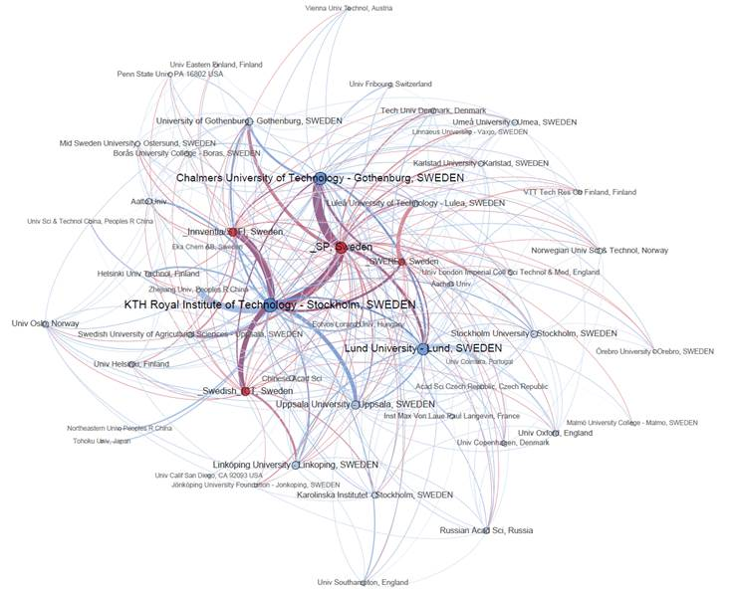
Examples of a co-publishing network
Example

Slide 15
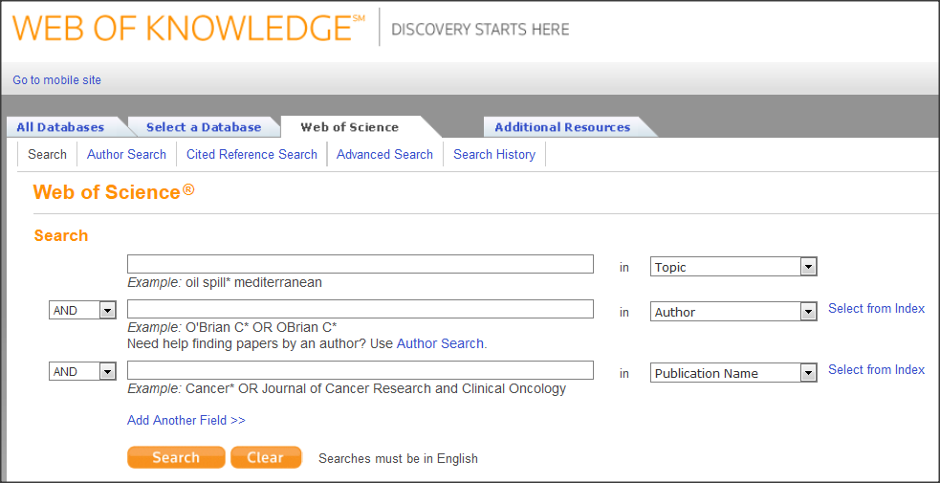
Citation
Research
Publication A
Reader
Writer
Publication B with Reference to the publication A

Slide 16
Bibliometric tools
Web of Science – industry standard
Scopus – rising star
Google Scholar via Publish or Perish
(Subject-specific tools)

Slide 17
Impact?
On society
On industry
On research community
As measured by the use of bibliometrics (citations)

Slide 18
Differences between research fields affecting bibliometric indicators
Publication pace (time for publishing and peer review process)
Length of publications
Number of references
Coverage of publications in citation database
Document type (e.g. reviews get more citations, proceedings papers are often excluded)
Size of research field

Slide 19
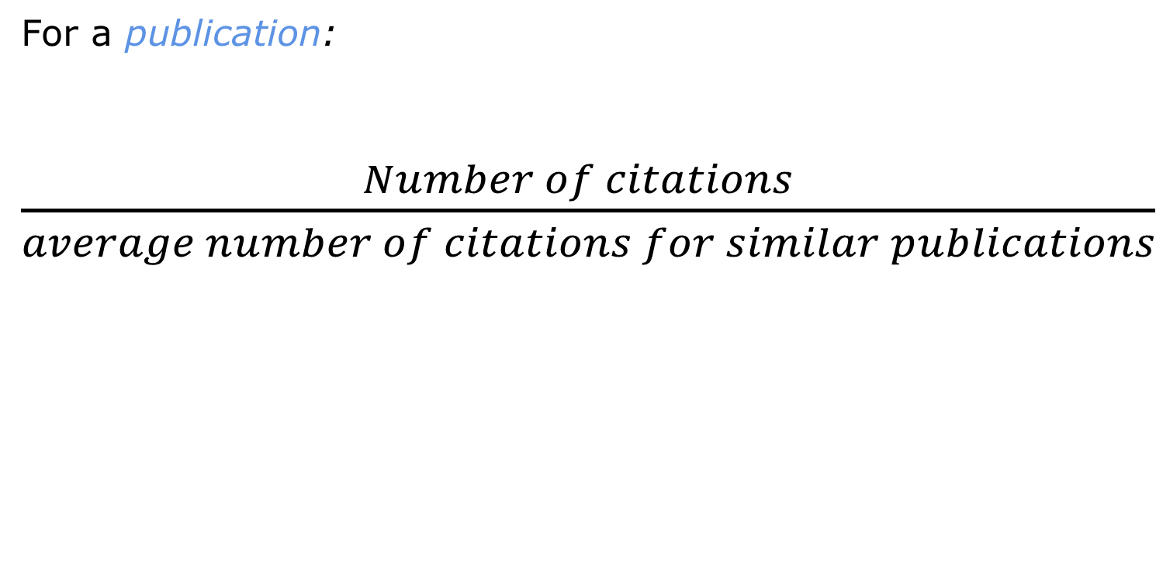
Field normalized citation rate
For a publication:
$\frac{Number of citations }{average number of citations for similar publications}$
Same research field
same year
same document type
Average = 1

Slide 20
Citation indicators > Research Quality
Correlation between peer review assessments and bibliometric indicators.
In general, high quality (as judged by peers) is needed to receive high citation scores at aggregated levels.
But not enough
There are research groups that get good judgments by reviewers but has low citation scores.
Research with impact outside the research community (e.g. applied research)
Research for which the bibliometric methods are improper.
Lutz Bornmann and Hans-Dieter Daniel, “Selection of Research Fellowship Recipients by Committee
Peer Review. Reliability, Fairness and Predictive Validity of Board of Trustees’ Decisions,”
Scientometrics 63, no. 2 (April 1, 2005): 297–320, doi:10.1007/s11192-005-0214-2; A. F. J. van Raan,
“Advanced Bibliometric Methods as Quantitative Core of Peer Review Based Evaluation and Foresight
Exercises,” Scientometrics 36, no. 3 (July 1, 1996): 397–420, doi:10.1007/BF02129602; Charles
Oppenheim, “The Correlation between Citation Counts and the 1992 Research Assessment Exercise
Ratings for British Research in Genetics, Anatomy and Archaeology,” Journal of Documentation 53,
no. 5 (December 1, 1997): 477–87, doi:10.1108/EUM0000000007207; Fler studier är refererade i
Bornmann and Daniel, “What Do Citation Counts Measure?”; och i Blaise Cronin, The Hand of Science:
Academic Writing and Its Rewards (Lanham, Md: Scarecrow Press, 2005), 125–129

Slide 21
Application and use
Macro
Peer review
Bibliometrics
Meso
Micro
Sybille Hinze. 2014. Nordic workshop on bibliometrics and research policy. Reykjavik, Iceland.

Slide 22
Bibliometrics at KTH
Research Assessment Exercise (research groups, UoA)
Funding allocation
Annual Bibliometric Monitoring
Reports and analyzes on demand from management and schools
Consultancy work for other universities

Slide 23
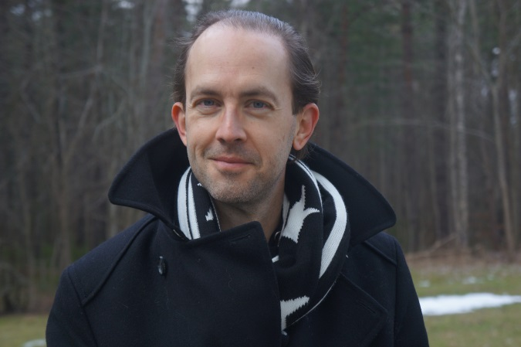
Time for discussion and

