Slide 1
KTH Library activities 2017
Sharing experiences of working at a technical university library
Dr. Göran Hamrin. Logician Lecturer Librarian
KTH Library Director of studies, ECE-school

Slide 2
KTH Royal institute of technology
Largest: 13 000 – 14 000 students
Oldest: 1827
”Best”: (QS University Ranking 2017)
Stockholm with surroundings
100 years (+ 1 month) on main campus Valhallavägen

Slide 3
KTH Royal institute of technology
Administration: Organised in Schools
Each educational program belongs to one school
15 MSc in Engineering programs (5-year)
”A lot” of BSc and BSc in Engineering (3-year Swedish)
>60 Master of Science programs (2-year English)
https://youtu.be/Sn2hApKmApI

Slide 4
Me before 2009
A straight-forward example of classical career choices:
High-school degree with top grades from prestige school
B.Sc. Mathematics and Computer science 1995
B.A Philosopy, Comparative literature, Economics 1995
Working at Dept. of Math, Uppsala university 1994-2008
Parental leave 2001-2003
Research in Mathematical logic, graduating Ph.Licentiate 2002 and PhD 2005.
Assistant professor of Mathematics 2006-2008, temporary teaching at UU and University of Gävle
No tenure!

Slide 5
Me from 2009
A serendipity-styled career choice:
”Too many kids, too many ex-wives”
Job tip from librarian friend: ”Information specialist at KTH Library (KTHB) – you would be good at it Göran!”
Ranked 2 out of 23 for the position and person ranked #1 declined the offer
Worked 4 years learning the trade, while updating the teaching activities at KTHB
Studied in parallell a MSc degree in Library and Information science (LIS)
Took up a position as Lecturer in LIS in 2013 and started leading the teaching group, leading by example

Slide 6
Me today
Director of studies
Leading the teaching group
Stopped counting the number of students taught…
…And tries to coach colleagues instead
Tries to test new pedagogics and technology…
…Instead of producing more written course material
Do give seminars in publication strategies and bibliometrics for PhD-students
Do work with setting up open data access unit at KTHB
Research focus: information literacy and blended learning plus some more theoretic information retrieval

Slide 7
Me: Facilitating research and learning
Working with two (of three) units at KTH Library:
Library services and learning support (=student and teacher support)
Publication infrastructure (=researcher support)

Slide 8
KTHB Teaching offer
Standardised offer sent to the coordinators for the educational programs twice/year
Offer consisting of teaching of different types
https://www.kth.se/en/kthb/kurser-och-stod/kurser/erbjudande-om-undervisning/erbjudande-om-undervisning-1.675304
Aiming for a 100 % presence of KTHB teaching for bachelor level students (65+% today)
Master level not that prioritised
Tries to increase teaching for PhD-students. Topics: IPR and patent databases, bibliometrics and publishing strategies

Slide 9
KTHB Research support offer
Publication support
Managing the KTH-DiVA publication archive
Fixing ORCID for everyone at KTH
KTH Publication policy curator
Open Access support when needed.
Providing publication lists for personal web pages of researchers
Aiming to slim publication processes in the future.
Example: https://www.kth.se/en/kthb/publicering

Slide 10
KTHB Research support offer, cont.
Bibliometrics support
For KTH management (Annual Bibliometric monitoring: https://intra.kth.se/bibliometri/public/start )
For larger research centers affiliated with KTH
Consulting for other universities and external partners
Aiming to be a future ”bibliometric (research) node”
Example project: The Vinnova /KTHB ”Bibcap project” (2014->): Publication database and method development for discovery and visualisation of research.

Slide 11
KTHB Media support
KTHB Media policy (Heavy focus on electronic full-text archive.)
Managing the discovery service platform KTHB Primo
…hence also managing the KTHB-web, the subscribing and buying of material, etc.
Challenges: Costs for subscriptions (Science Direct costed around 1/3 of media budget), etc.
Library system ALMA integrated with Primo

Slide 12
Other activities
Re-furnishing the library building (6+ months, 2016)
Increase in visiting statistics (+10-20 % )
900 study spaces! (http://www.pronova.se/projekt/kth-campus )
Starting more open talks / seminars with invited KTH-researchers.
Exhibitions: https://www.kth.se/en/kthb/aktuellt/nyheter/ny-utstallning-sensing-energy-1.746363
Academic resource center: A platform for writing, information searching, math, career support, with lunch seminars and individual support on request.
https://www.kth.se/en/kthb/kurser-och-stod/stod/arc

Slide 13
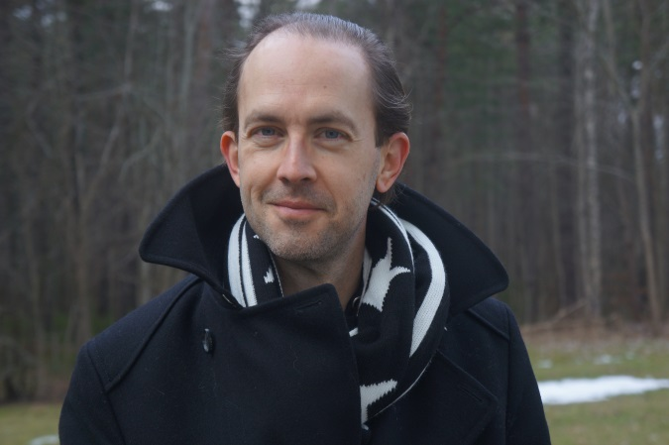
Time for disussion!

