Slide 1

Getting the Most from NTK
Workshop for The English College
in Prague
18.11.2016, Dr. Stephanie Krueger
10.10-11.10

Slide 2

Today (10:10-11:10)
Historical context
Accessing resources from home
  Exercise: Login and explore
One search box, all resources
  Exercise: Search for peer-review articles, eBooks
Content gems
  Exercise in pairs: Explore and discuss a database
Special services
  Interlibrary loan
  Student workshops, beyond library content:
    Academic integrity
    Tools for staying organized, managing references, and making a literature review/bibliography

Slide 3
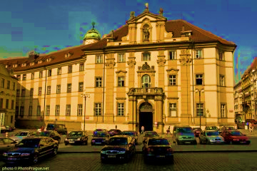
Historical context
1718: Czech Estates Decree Professorship of Engineering for teaching "military skills" (i.e., construction of fortifications)
1935: Renovated wing, Clementinum
2009: Current building opens
More info, historical materials
Image: Daniel Baránek, Klementinum, východní strana, vstup z Mariánského náměstí. 2008. Wikipedia Commons.

Slide 4
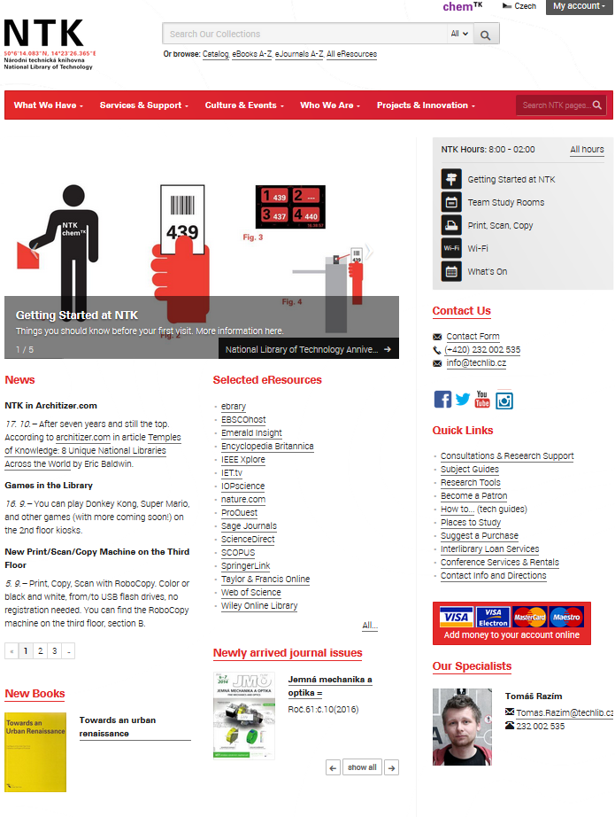
Remote access to resources
Wherever, whenever: techlib.cz/en
Crucial: login with username and password

Slide 5
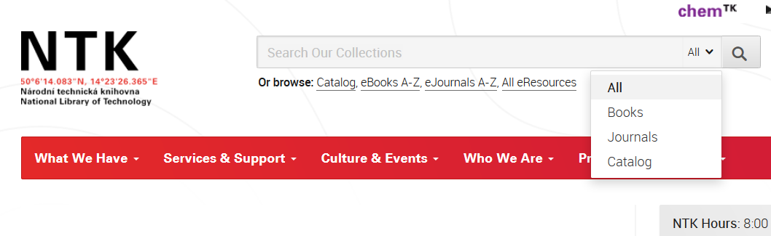
Discovering scholarly materials
techlib.cz/en
One search box to rule them all
  Includes eBooks and eJournals
  “Catalog”: print materials in the library

Slide 6
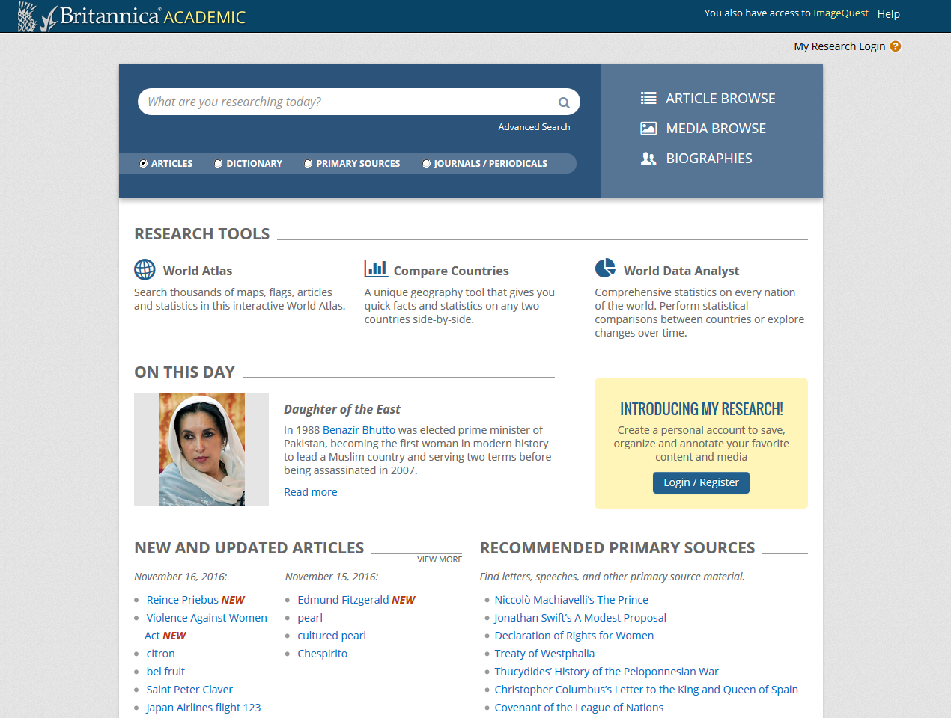
Content gems
Current issues of Science and Nature
Databases which span disciplinary boundaries, including social sciences and humanities in addition to STEM
  Britannica Academic (citable dictionary, biographies, terms, images, primary sources)
  EBSCOhost
  EmeraldInsight
  ProQuest
  SpringerLink
  Wiley Online Library

Slide 7
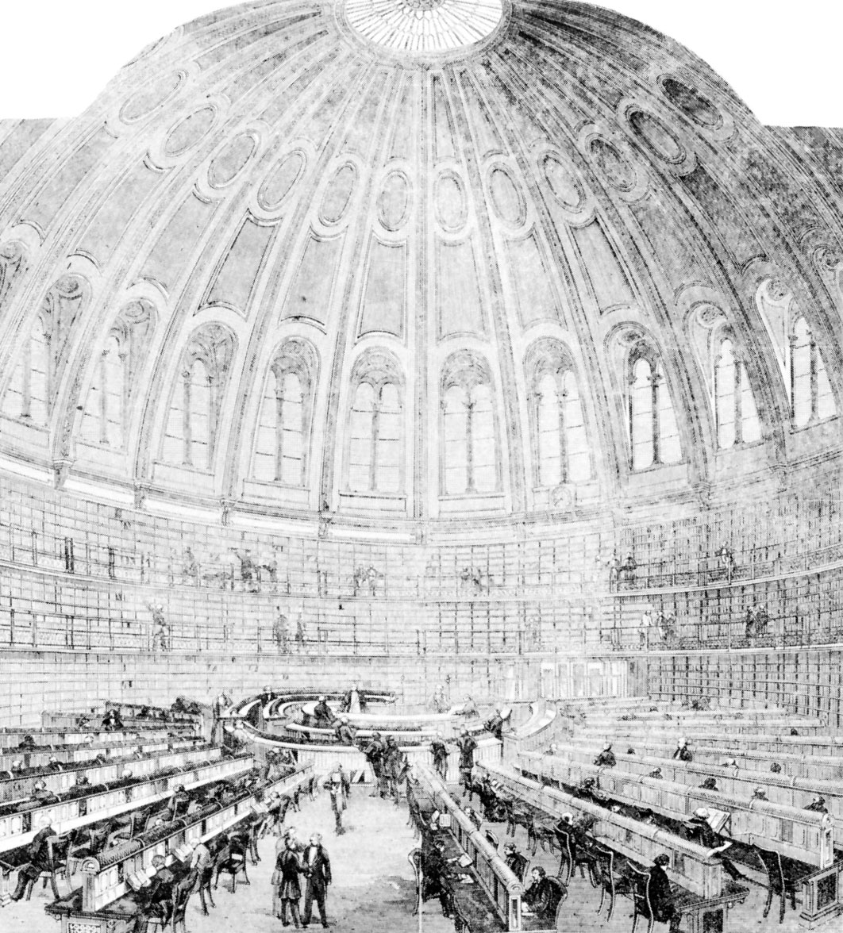
Interlibrary loan
Order materials not in Czech libraries
  Sample partner: British Library
Coordinate via reference team
Fees depending on lending library
  Base fee: 250 CZK/some 500 CZK
  Plus any copy fees
Pick up, drop off at the library
  In future, if high demand, we can develop new system with Mike Hubbell
Image: British Library: Reading Room. Image. Britannica Academic, Encyclopædia Britannica, 19 Sep. 2016. media1.academic.eb.com/eb-media/98/2098-050-94B148D6.jpg. Accessed 16 Nov. 2016.

Slide 8
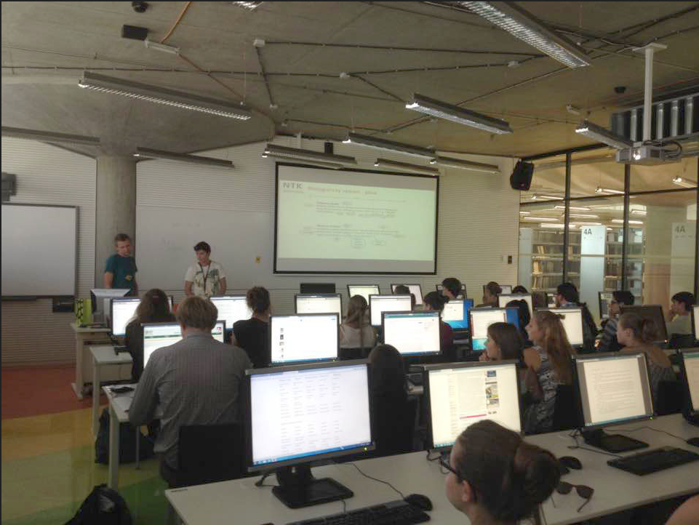
Student workshops

Slide 9
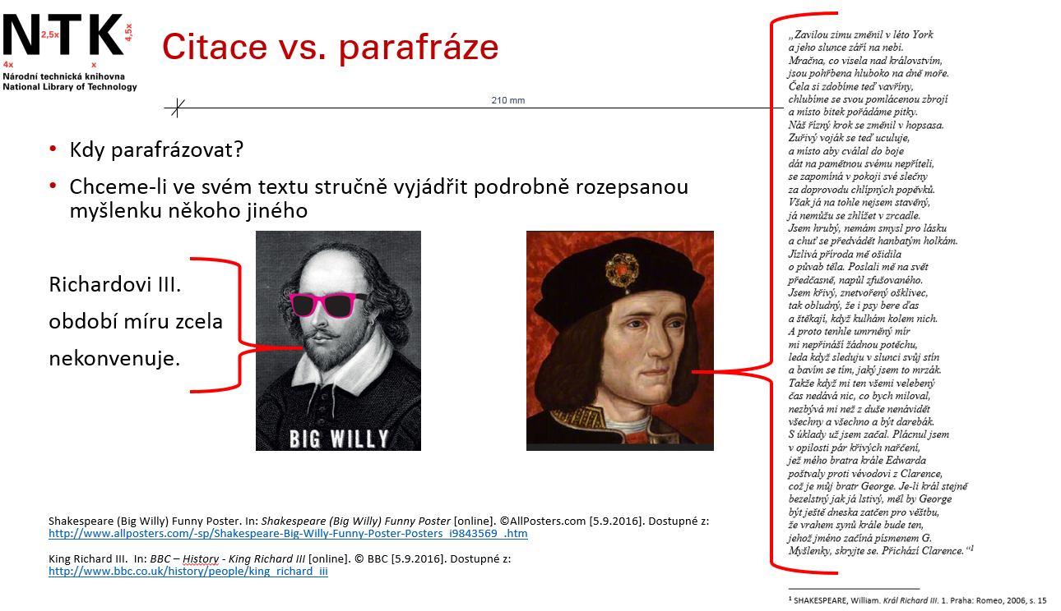
Content: academic integrity
Slide authors: Mgr. Pavlína Tvrdá and Mgr. Tomáš Razím, 2016

Slide 10



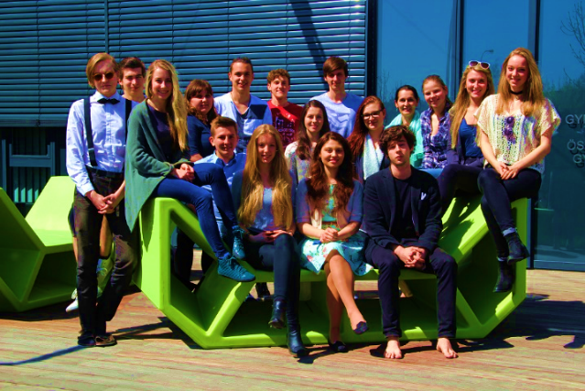


Content: staying organized, referencing, literature review
= Free
= NTK subscription
1. Harvest citations, PDFs from open internet, online library resources using:
= Free, if registered; mobile support
2. Reference Management Tools
Organize Citations & PDFs
Fix Data
3. Word Processor
Insert Citations
Create Bibliography
Image: Austrian School in Prague, 2016

Slide 11
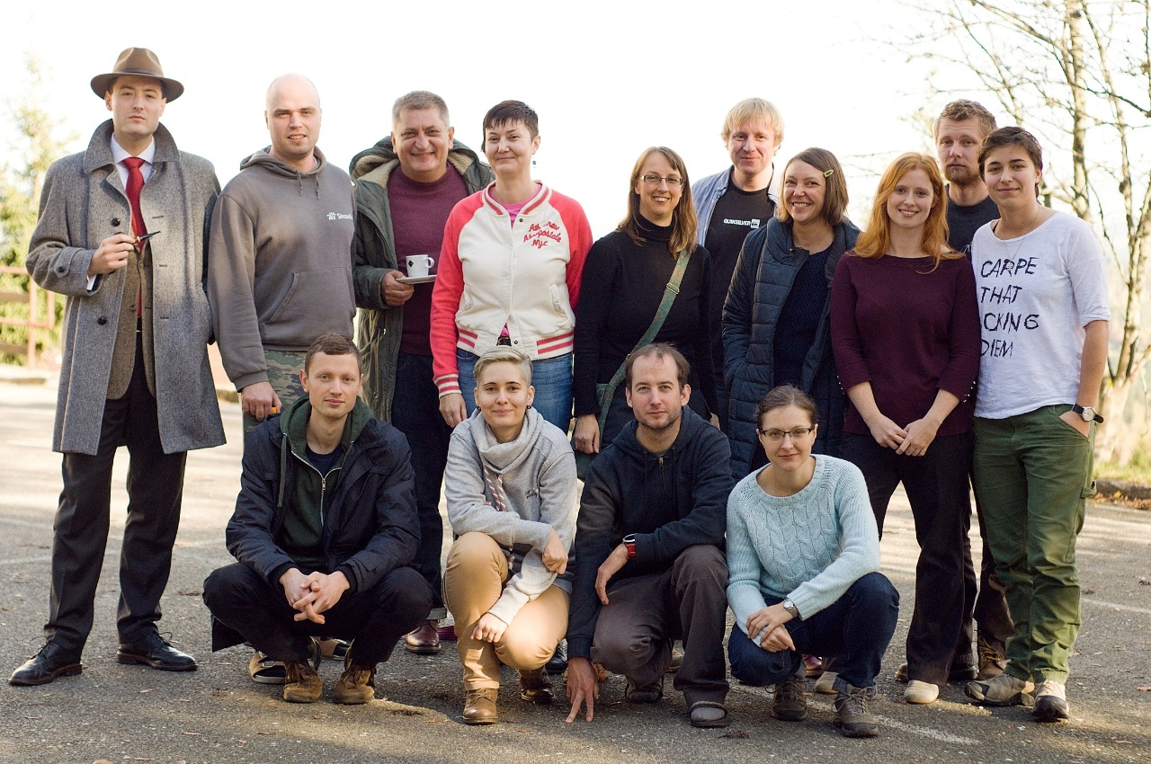
Contact
techlib.cz/en
FB (CZ and EN)
Twitter (CZ)
We’re here for you
  Contact Mike Hubbell
  reference@techlib.cz
  (+420) 232 002 503
  NTK service desk: M-F 8:00 - 20:00

