Slide 1

How to formulate your research question?
And how to plan your research activities
Pavlína Tassanyi, Filip Strych, June 14th, 2018

Slide 2
Outline
Key features of a research question
How to develop a research question
Difference between a research question and a thesis statement
Examples
How to manage your time when researching your topic

Slide 3
Topic
Choose something you are interested in – you will spend a lot of time on it
Choose something you can handle – both intellectually and mentally
I‘m not going to write about:
Euclidean algorithm if I don‘t know what an algorithm is … and hate math
Latin poetry in Latin if I don‘t know Latin… and hate poetry
Suicide rate amongst teenagers if I don‘t have the numbers (and don‘t know where to get them) … and hate statistics

Slide 4
Research question – RQ
RQ is something that can help you stay focused while writing but only if it‘s defined properly
Since you have limit you must be as precise as possible – your EE must end (eventually)
It is like a spine which holds the body (the research itself) together – as you progress, you will support it (adding more “bones and muscles“)

Slide 5
A good RQ is:
Relevant
Manageable
Substantial and original
Interesting
Arguable

Slide 6
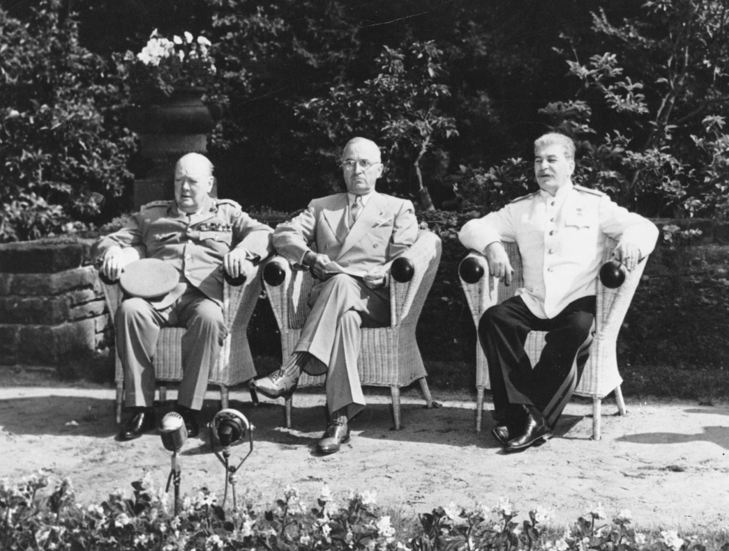
Relevant RQ
Does the question fit your topic?
Has the question been answered before?
Is it too easy to answer?
How did the Second World War change the world?
What were the social impacts of Second World War in the Central Bohemia region?
Churchill, Winston; Truman, Harry; Stalin, Joseph [Image]. Encyclopædia Britannica. Retrieved 4 June 2018, from https://academic.eb.com/levels/collegiate/assembly/view/92072

Slide 7
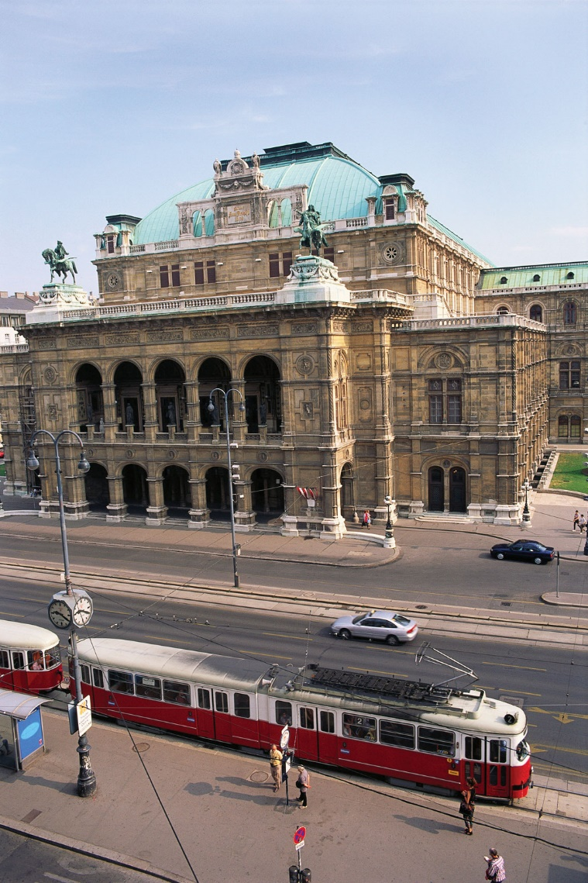
Manageable RQ
Are you realistic about the scope and scale of the topic?
Can you access and collect all necessary sources and/or data?
What are the urban problems of big European cities?
What are the differences between Vienna and Prague tramway system?
Vienna State Opera [Image]. Encyclopædia Britannica. Retrieved 5 June 2018, from https://academic.eb.com/levels/collegiate/assembly/view/228985

Slide 8
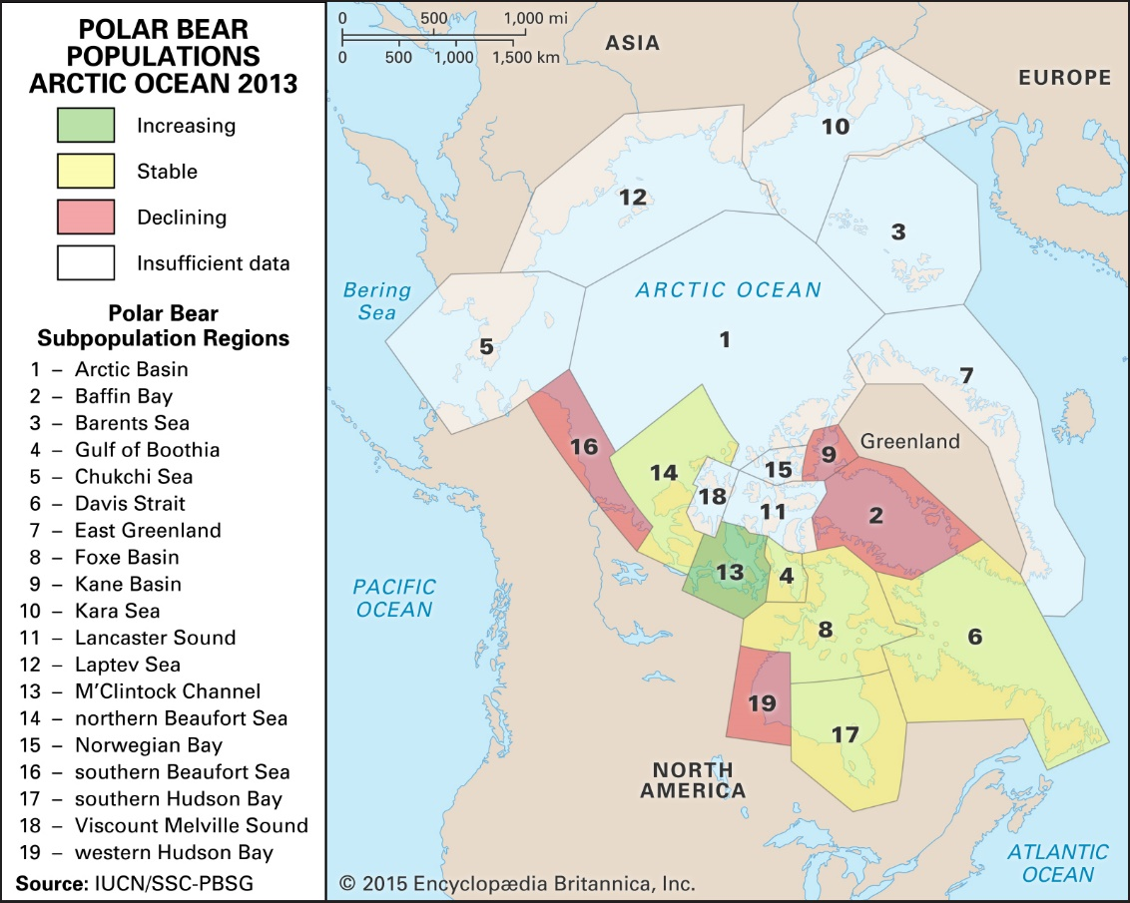
Substantial and original RQ
Showing your own imagination/ability to analyze
Showing how you interpret the subject of your essay
What is the effect of global warming?
How is glacial melting affecting polar bears in the Arctic?
Polar bear populations in the Arctic [Image]. Encyclopædia Britannica. Retrieved 4 June 2018, from https://academic.eb.com/levels/collegiate/assembly/view/202245

Slide 9
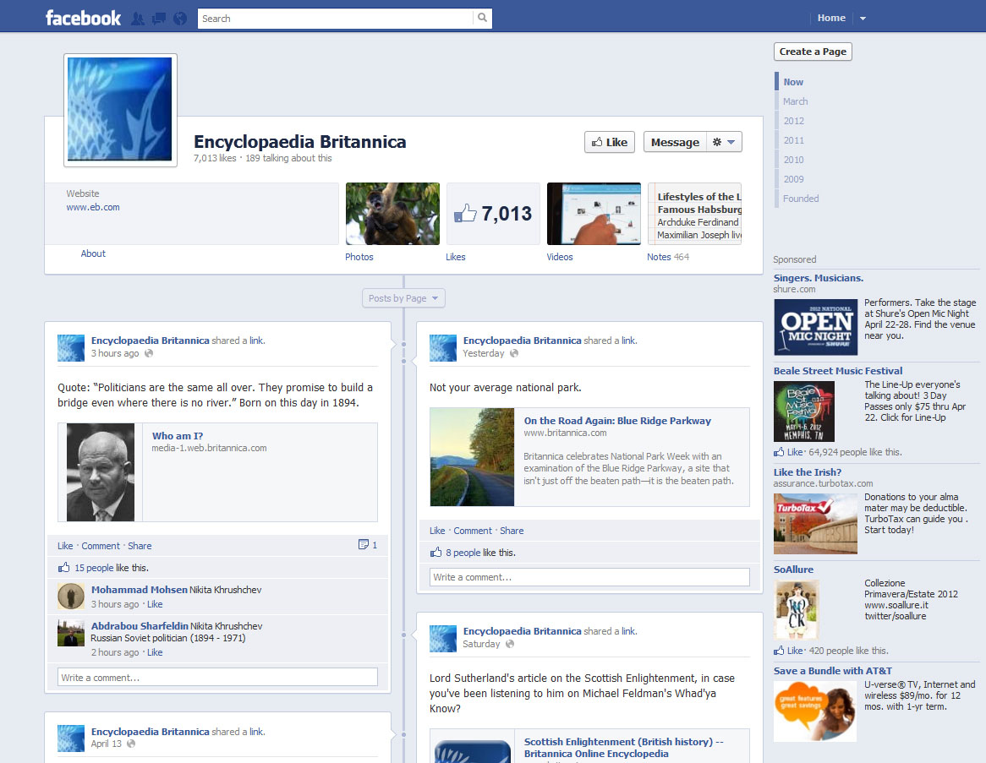
Interesting RQ
What is the most important aspect of your RQ (for you, for others)?
You will spend time working on it
Try not to be flashy
Why is social media so addictive?
How does Facebook use psychology to steal our attention and why is it harmful for our productivity?
Facebook: Facebook profile page, Image, from Encyclopædia Britannica, accessed June 5, 2018, https://academic.eb.com/levels/collegiate/assembly/view/148392.

Slide 10
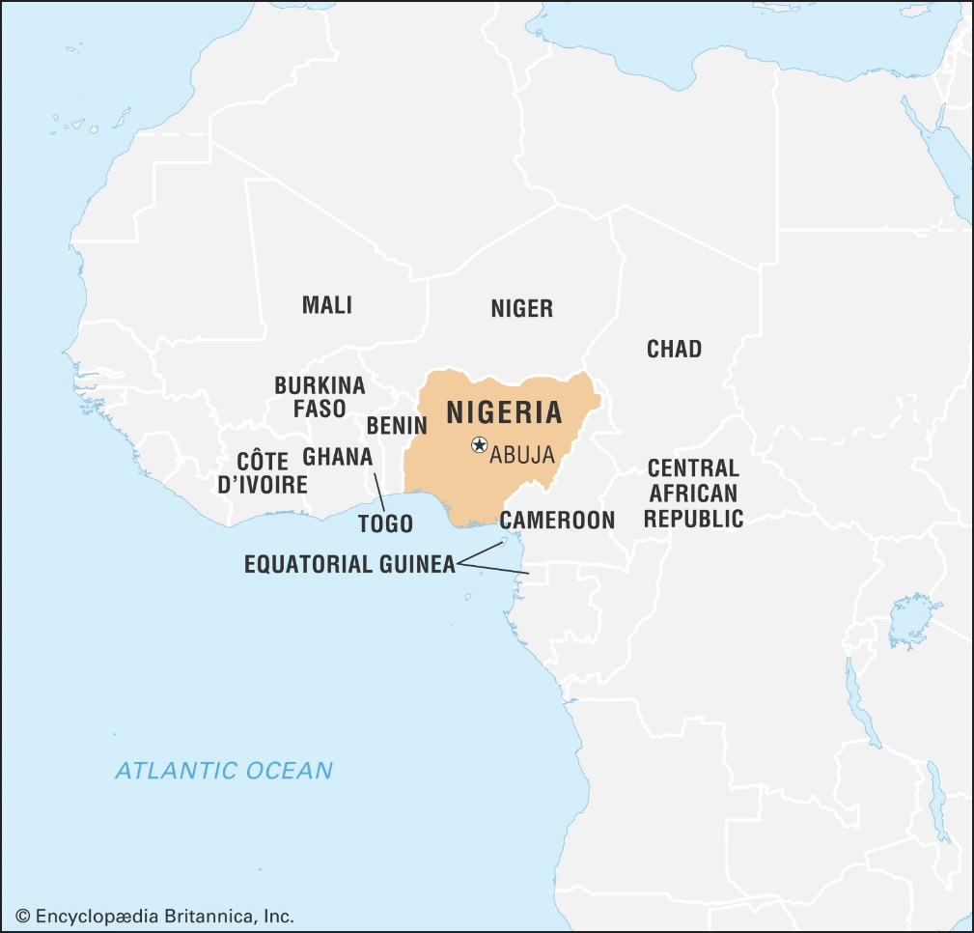
Arguable RQ
Consider the supporting arguments and logic
Think about possible limitations and obstacles
Take into account counterarguments
Is Africa an underdeveloped region?
How can Nigeria benefit from global trade and become a more developed country?
Nigeria [Image]. Encyclopædia Britannica. Retrieved 4 June 2018, from https://academic.eb.com/levels/collegiate/assembly/view/225285

Slide 11
A good RQ is:
Relevant
Manageable
Substantial and original
Interesting
Arguable
Remember, if you don’t ask a good question, you cannot expect a good answer, or any answer.

Slide 12
Research question vs Thesis statement
Asking something – question
I have question
I‘m working on answering it
Claiming something – statement
I think I have the answer
I‘m working on proving it

Slide 13
Thesis statement: Examples
The Second World War did not change the world.
People in Eastern Europe started being skeptical of the right wing parties after the Second World War.
There are effects of global warming.
Producing single-used plastics has caused severe damages to the world environment in recent years.

Slide 14
Thesis statement: Examples
Social media is addictive.
Facebook is built to steal its user‘s attention.

Slide 15
Preliminary research

Slide 16
General topic specific RQ
Search in current books, periodicals, journals:
What has been already written, described?
How did the previous authors make their inquiry more specific?

Slide 17
General topic specific RQ
Ask questions – plan your research:
Why Why do I want to write about it (interesting, not covered yet)
What What do I plan to argue? What do I want to prove?
How How will I prove my point? Will I be able to cover it in my
theses? Which method will I use?

Slide 18
Tips
Discuss your questions with someone (supervisor at least)
Try to be as specific as possible right from the beginning
What kind of argument are you hoping to make or support?
What do you need to do in order to accomplish your research?
What to do if your research disputes your argument?
Don‘t forget: Negative results are results too

Slide 19
Exercise
Choose your own topic
Ask yourself what you want to research
Try to develop a basic research question

Slide 20
Time management

Slide 21
Time management
Have you ever used some kind of time management?
If not, why?
Why is it important to manage your time?
How can it help you and your research?

Slide 22
Plan your research in advance
Start immediately
Work each day at least a bit
Plan each stage of your research and set your own deadlines
Always double/triple your estimated time
Stay in touch with your supervisor

Slide 23
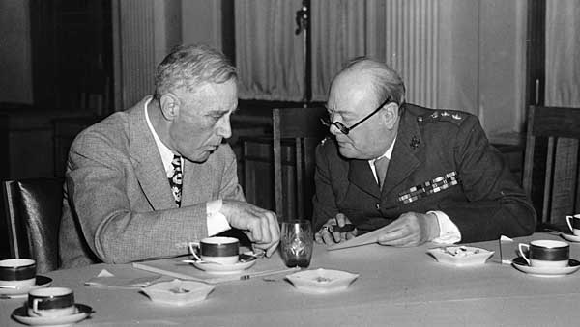
With a plan:
You will know what to do next
You will stop wondering
You will advance to the next stage
Roosevelt, Franklin D.; Churchill, Winston; Yalta Conference, Image, from Encyclopædia Britannica, accessed June 5, 2018, https://academic.eb.com/levels/collegiate/assembly/view/72138.

Slide 24
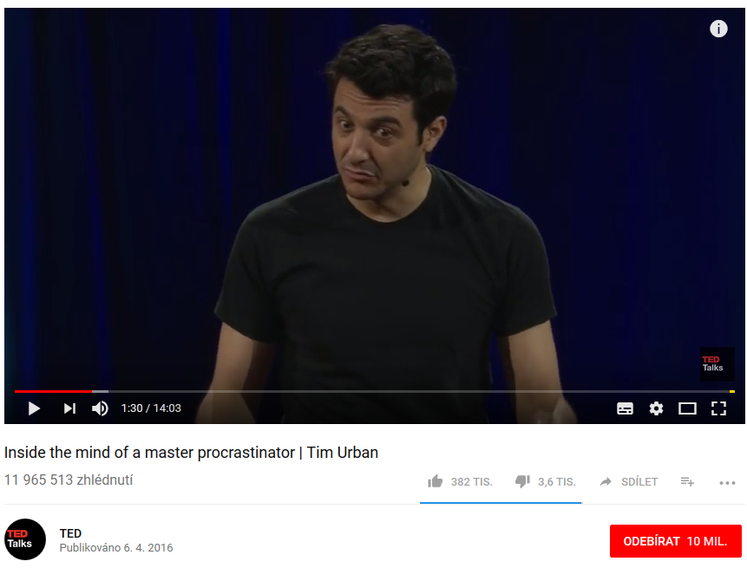
Be aware of:
Loops: “I do not have enough resources/data. "
Procrastination: “I need to clear my desk before I start.“
Unrealistic goals/achievements: “I will write my essay a week before the deadline. It‘s too far from now.“
TED Talks. Inside the mind of a master procrastinator | Tim Urban. Video, from YouTube, accessed June 5, 2018 https://www.youtube.com/watch?v=arj7oStGLkU.

Slide 25
You can get stuck:
Writing: “It has to be nicely done. The other things will go in hand.“
Editing: “I will do references later. Now I don‘t have time for this.“

Slide 26
Summary
Think about your research question as a spine
Ask questions: “What“ and “How“ do you plan to discuss your research?
Double the estimated time
Do not procrastinate. Work a bit each day ☺

Slide 27
Evaluate us

